Slide 1
Module-4
DESIGN OF EXPERIMENTS AND OPTIMIZATION METHODS
Design of experiments; Basic experimental designs; Completely randomized design; Randomized block design; Latin square design; Full factorial design - 2², 2³ and 2^{k}; Fractional factorial designs; Taguchi methodology – Orthogonal array; S/N ratio – Taguchi method for optimization; Response surface method – multi response optimization. Global optimization techniques – evolutionary and swarm algorithms – examples and case studies.

Slide 2
Design of Experiment (DOE) Terminology
Factors
Controllable variables that are deliberately manipulated to determine the individual and joint effects on the response(s), OR Factors are those quantities that affect the outcome of an experiment, Example: heat source, lid, shape of pot etc.
A variable or attribute which influences or is suspected of influencing the characteristic being investigated. All input variables which affect the output of a system are factors
Factors are varied in the experiment. They can be controlled at fixed levels. They can be varied or set at levels of our interest.
Two types of variables or factors : quantitative and qualitative
Quantitative – how the range of settings to be measured and controlled e.g. temperature , pressure in the process yield experiment
These are also called independent variables.
Levels
Specified value or setting of the factor being examined in the experiment.
The values of a factor/independent variable being examined in an experiment.
If the factor is an attribute, each of its state is a level.
For example, setting of a switch on or off are the two levels of the factor switch setting.
- If the factor is a variable, the range is divided into required number of levels.
For example, the factor temperature ranges from 1000 to 1200°C and it is to be studied at three values say 1000°C, 1100°C and 1200°C, these three values are the three levels of the factor temperature.
The levels can be fixed or random.

Slide 3
DOE Terminology
Treatment
One set of levels of all factors employed in a given experimental trial.
For example, an experiment conducted using temperature T1 and pressure P1 would constitute one treatment.
In the case of single factor experiment, each level of the factor is a treatment.
Run or trial :
a trial or run is a certain combination of factor levels whose effect on the output (or performance characteristic) is of interest.
Replication
Replication is a systematic duplication of series of experimental runs. It provides the means of measuring precision by calculating the experimental error.
Noise
Variables that affect product/ process performance, whose values cannot be controlled or are not controlled for economic reasons. Eg. Climate, environment, etc….

Slide 4
DOE Terminology
Experimental unit
Facility with which an experimental trial is conducted such as samples of material, person, animal, plant, etc.
Response:
The result/output obtained from a trial of an experiment. This is also called dependent variable. Examples are yield, tensile strength, surface finish, number of defectives, etc.
Effect :
Effect of a factor is the change in response due to change in the level of the factor.
Experimental error:
It is the variation in response when the same experiment is repeated, caused by conditions not controlled in the experiment.
It is estimated as the residual variation after the effects have been removed.

Slide 5
Need for DOE methodology
Experimental design methods are also of fundamental importance in engineering design activities, where new products are developed and existing ones improved. Some applications of experimental design in engineering design include
1. Evaluation and comparison of basic design configurations
2. Evaluation of material alternatives
3. Selection of design parameters so that the product will work well under a wide variety
of field conditions, that is, so that the product is robust
4. Determination of key product design parameters that impact product performance
5. Formulation of new products.
The use of experimental design in product realization can result in products that are easier to manufacture and that have enhanced field performance and reliability, lower product cost, and shorter product design and development time.
Designed experiments also have extensive applications in marketing, market research, transactional and service operations, and general business operations.

Slide 6
Full factorial design, Basic concepts of 2², 2³ and 2^{k} designs
It is widely accepted that the most commonly used experimental designs in manufacturing companies are full and fractional factorial designs at 2-levels and 3-levels.
Factorial designs would enable an experimenter to study the joint effect of the factors (or process/design parameters) on a response.
A full factorial design consists of all possible factor combinations in a test, and, most importantly, varies the factors simultaneously rather than one factor at a time.
Using this approach, the tester can examine both main effects (effect of the independent variables on the dependent variable) and interactions (effect of the interaction between independent variables on the dependent variable) associated with both categorical and continuous factors.

Slide 7
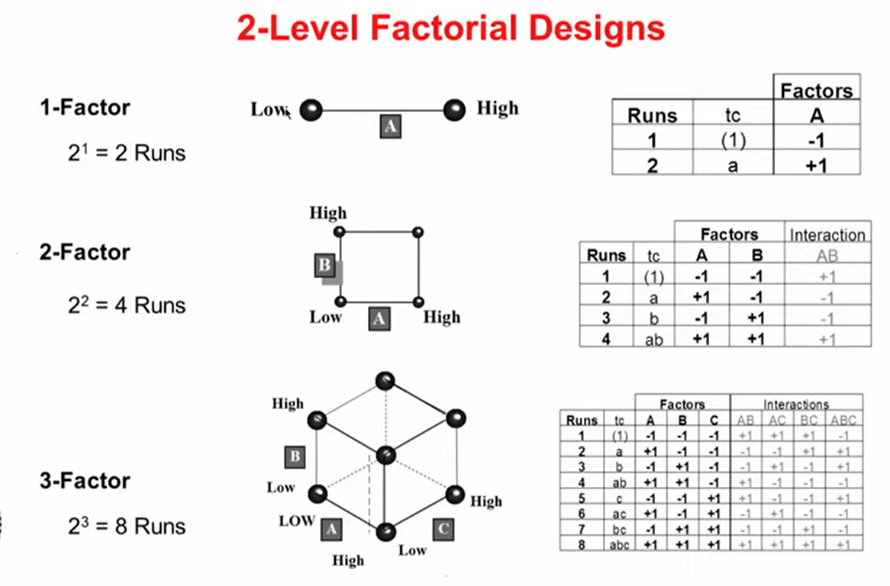
Full factorial design, Basic concepts of 2², 2³ and 2^{k} designs

Slide 8
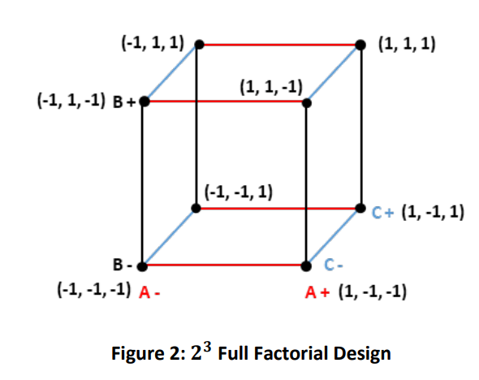
Full factorial design, Basic concepts of 2², 2³ and 2^{k} designs

Slide 9

Full factorial design, Basic concepts of 2², 2³ and 2^{k} designs
All the experimental design should be balanced and orthogonal.
Balanced: in terms of factors
Orthogonal: in terms of interactions.
Factorial Design always balanced and orthogonal.
Also, it should be Unbiased.

Slide 10
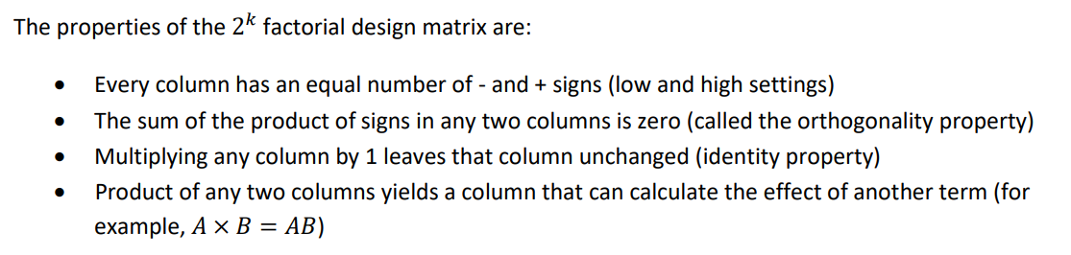
Full factorial design, Basic concepts of 2², 2³ and 2^{k} designs

Slide 11


Slide 12
A 2² design is a simple factorial design where there are two factors, each at two levels. It’s often used in experimental design to evaluate the effect of two factors and their interaction. Here’s an example:
Example Scenario
Suppose we’re testing two factors in a product manufacturing process:
Factor A: Temperature (with levels: Low and High)
Factor B: Pressure (with levels: Low and High)
Experimental Design Layout
In a 2² factorial design, there are four experimental conditions, as shown below. Each cell represents a unique combination of the levels of factors A and B:
Run | Factor A (Temperature) | Factor B (Pressure) | Outcome (e.g., Product Quality)
1 | Low | Low | (Result 1)
2 | Low | High | (Result 2)
3 | High | Low | (Result 3)
4 | High | High | (Result 4)

Slide 13
Analyzing the Design
This 2² design allows you to estimate:
The main effect of each factor (Temperature and Pressure),
The interaction effect between Temperature and Pressure.
For example, if the product quality significantly changes depending on the combination of temperature and pressure, the interaction effect would be significant.
In practice, you’d use statistical analysis (e.g., ANOVA) to determine the effects and interactions from the outcomes of each run.

Slide 14
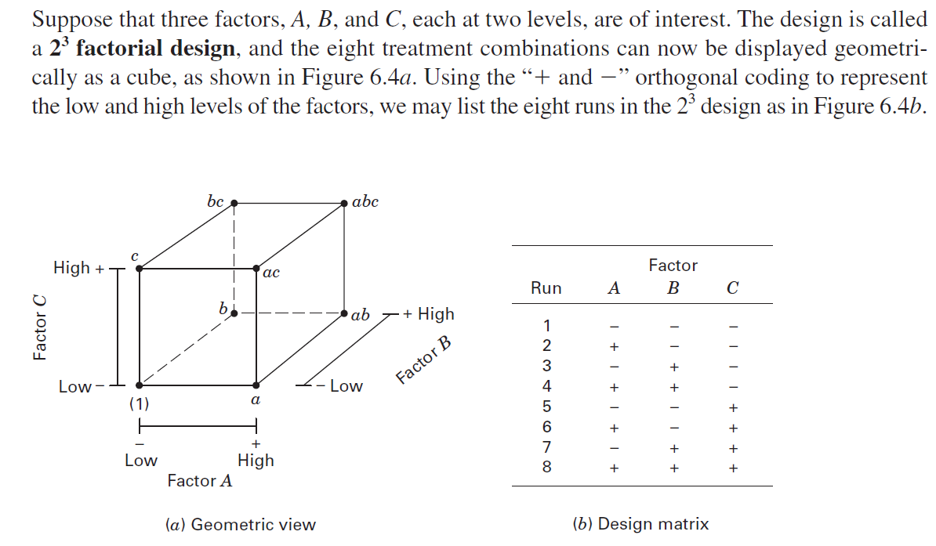
2³ design

Slide 15
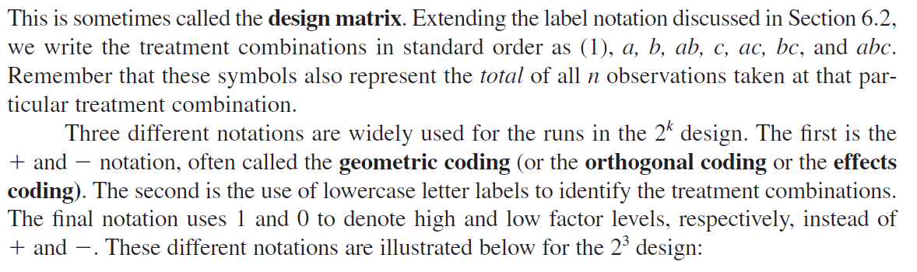
2³ design

Slide 16
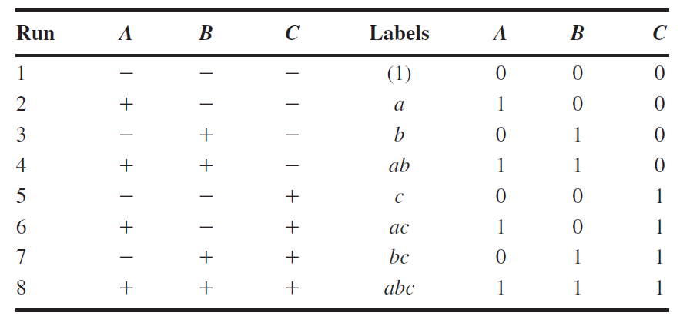
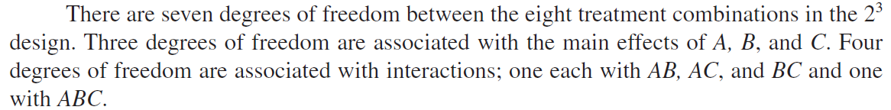
2³ design

Slide 17
A 2³ design is a factorial design involving three factors, each at two levels.
This setup results in eight experimental conditions (since 2³=8).
In a 2³ design, we can investigate the main effects of each factor, as well as the two-way and three-way interactions among them.
Example Scenario
Let’s consider a manufacturing process where we want to test three factors:
Factor A: Temperature (Low, High)
Factor B: Pressure (Low, High)
Factor C: Time (Short, Long)

Slide 18
Experimental Design Layout
This design has eight runs, one for each combination of the factors. Here’s what the layout would look like:
Run | Factor A (Temperature) | Factor B (Pressure) | Factor C (Time) | Outcome (e.g., Product Quality)
1 | Low | Low | Short | (Result 1)
2 | Low | Low | Long | (Result 2)
3 | Low | High | Short | (Result 3)
4 | Low | High | Long | (Result 4)
5 | High | Low | Short | (Result 5)
6 | High | Low | Long | (Result 6)
7 | High | High | Short | (Result 7)
8 | High | High | Long | (Result 8)

Slide 19
Analyzing the 2³ Design
With a 2³ design, we can analyze:
Main effects: The individual impact of Temperature, Pressure, and Time.
Two-way interactions: How each pair of factors interacts (e.g., Temperature * Pressure, Temperature * Time, Pressure * Time).
Three-way interaction: How all three factors together impact the outcome (Temperature * Pressure * Time).
This setup allows for a detailed analysis of both individual and combined effects of the factors on the outcome.
You would typically use statistical tools, such as ANOVA, to interpret these effects and determine if they are statistically significant.

Slide 20

Taguchi Method
Robust Design method, also called the Taguchi Method, pioneered by Dr. Genichi Taguchi, greatly improves engineering productivity.
Genichi Taguchi (1 January 1924 – 2 June 2012) was a statistician and engineer. He obtained his Ph.D. in Statistics and Mathematics Science at Kyushu University University, Japan in 1962.

Slide 21
Taguchi Method
The Taguchi Methodology is a design of experiments (DOE) technique that focuses on optimizing process parameters and improving quality by minimizing the effect of uncontrollable variations (noise).
It’s widely used in engineering, manufacturing, and research to achieve consistent performance at low cost.
Objectives
Improve product or process quality and reliability
Identify optimal parameter settings with minimum experimentation
Reduce variation (noise) and waste
Enhance robustness of the design
Applications
Manufacturing process optimization (casting, machining, welding)
Electrical & electronic design (power converters, circuits)
Quality control and reliability engineering
Product and material design

Slide 22
Taguchi Method
Concept | Description
Control Factors | Process parameters that can be adjusted (e.g., voltage, pressure, speed).
Noise Factors | Uncontrollable variables that cause variation (e.g., temperature, humidity).
Signal-to-Noise (S/N) Ratio | Measure used to identify parameter settings that minimize variability.
Orthogonal Arrays (OAs) | Structured experimental designs that reduce the number of trials while covering all factor combinations efficiently.

Slide 23
Taguchi Method
Steps in Taguchi Methodology
Identify the objective – e.g., maximize efficiency, minimize defects.
Select the output response (performance measure).
Determine control and noise factors.
Choose an appropriate Orthogonal Array (OA) – e.g., L9, L16, L27 depending on factors and levels.
Conduct experiments according to the OA.
Calculate the S/N ratio for each trial.
Analyze results using main effect plots or ANOVA.
Select optimal parameters and perform confirmation tests.

Slide 24
Taguchi Method
Objective | Formula | Meaning
Smaller-the-better | S/N = -10 log₁₀(Σy²/n) | For minimizing defects, errors, or losses
Larger-the-better | S/N = -10 log₁₀(Σ(1/y²)/n) | For maximizing efficiency or output
Nominal-the-best | S/N = 10 log₁₀(μ²/σ²) | For achieving a target value with minimum variation

Slide 25
Taguchi Method
Advantages
Reduces time and cost of experimentation
Identifies robust settings with fewer trials
Improves quality without major design changes
Provides clear quantitative insight (via S/N ratios)
An engineer wants to optimize the efficiency of a DC motor by studying 3 factors —
Armature voltage (A),
Field current (B),
Load torque (C), each at 3 levels.
Instead of 27 trials (3³), Taguchi’s L9 orthogonal array requires only 9 experiments, still giving sufficient information to find the best combination for maximum efficiency.

Slide 26
What is robust design?
Robust design is an “engineering methodology for improving productivity during research and development so that high-quality products can be produced.
Robust Design is a technique that reduces variation in a product by reducing the sensitivity of the design of the product to sources of variation rather than by controlling their sources. The end result is a robust design, a design that has minimum sensitivity to variations in uncontrollable factors

Slide 27
What is robust design?
What is Robust?
A system (product or process) is robust if it performs properly in a wide range of conditions.
Robust Products | Products that are not robust
A pen that writes until the ink is empty | Pen that stops writing after a few months
A car that starts at -20 deg | A car that does not start
A vacuum cleaner that maintains suction levels | A vacuum cleaner that loses suction
In the design of a new product, any design activity can be called robust, if it leads the
product;
To have longer life (higher reliability)
To be more consistent with use
To be more consistent from product to product
To perform consistently as temperature and other conditions change
Notes:
https://www.youtube.com/watch?v=4ti8rfzh4xg

Slide 28
What is robust design?
Products and services should be designed to be inherently defect free and high quality
Meet customer’s expectations also under non-ideal conditions
Disturbances are events that cause the design performance to deviate from its target value
Taguchi divide disturbances into three categories
External disturbances: variation in the environment where the product is used
Internal disturbances: wear and tear inside a specific unit
Disturbances in the production process: deviation from target values

Slide 29
What is robust design?
A three step method for achieving robust design (Taguchi)
Concept design
Parameter design
Tolerance design
Concept Design / System Design
The process of examining competing technologies for producing a product – Includes choices of technology and process design.
A prototype design that can be produced and meets customers needs under ideal conditions without disturbances

Slide 30
What is robust design?
2. Parameter Design
The selection of control factors (parameters) and their optimal levels
The objective is to make the design Robust!
Control factors are those process variables management can influence
Ex. The procedures used and the type and amount of training
Often a complex (non-linear) relationship between the control factors and product / design performance
The optimal parameter levels can be determined through experimentation.
3. Tolerance Design
Development of specification limits
Necessary because there will always be some variation in the production process
Taguchi fiercely advocates aiming for the target value not just settle for inside the specification limits.
Occurs after the parameter design
Often results in increased production costs
More expensive input material might have to be used to meet specifications.
Interchangeability.

Slide 31
Background of the Taguchi Method
Unique aspects of the Taguchi Method
The Taguchi definition of quality
The Taguchi Quality Loss Function (QLF)
The concept of Robust Design
The Taguchi definition of quality
Ideal quality refers to a target value for determining the quality level
Ideal quality is delivered if a product or service tangible performs its intended function throughout its projected life under reasonable operating conditions without harmful side effects
Ideal quality is a function of customer perception and satisfaction
Service quality is measured in terms of loss to society

Slide 32
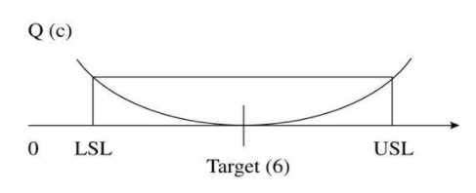
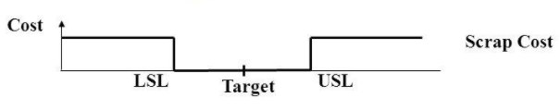
Background of the Taguchi Method
2. Taguchi Quality Loss Function (QLF)
Taguchi defines Quality as “the loss imparted by the product to society from the time the product is shipped”
LOSS = Cost to operate, Failure to function, maintenance and repair cost, customer satisfaction, poor design.
Product to be produced “being within specification

Slide 33
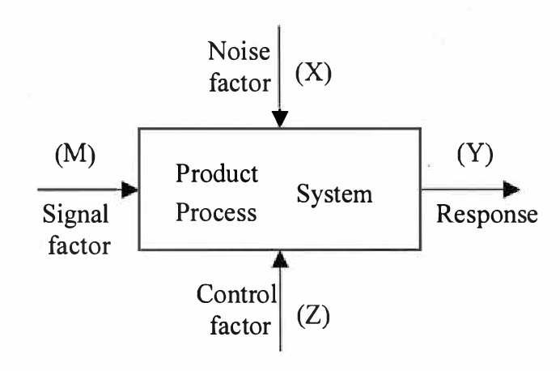
Taguchi Terminology
A schematic representation of a product / process is shown in a figure. The response is denoted by y and is called quality characteristics.
The parameters that influence the quality characteristic are classified as follows:
Signal factor (M): These are the parameters set by the user or operator of the product to express the intended value for the response of the product based on the knowledge of the product being developed. Sometimes 2 or more signal factors may also be used in combination to express the desired response.

Slide 34
Taguchi Terminology
Noise factor (x): Certain parameters are not controllable by the designer and are known as noise factors. Parameters whose settings (also called levels) are difficult to control in the field or whose levels are expensive to control are also considered noise factors. The levels of the noise factors change from one unit to another, from one environment to another, and from time to time. The noise factors cause the response y to deviate from the target specified by the signal factor M and lead to quality loss.
Control factor (z): These are parameters that can be specified by the designer. Control factor can take multiple values, called levels.

Slide 35
Taguchi Method is quite different:
For examples, if there are seven variables that can each be set at two levels, then the total number of experiments possible is given by Level of the power of factors, that is (2⁷) = 128.
It allows to vary all the factors at a time and still let us evaluate the effect of each individual factor.
Also, it allows us to do limited number of experiments and then provides a method for predicting the other untried combinations. For examples, in the cited example, Taguchi method suggests doing only 8 experiments to understand the 128 combinations.

Slide 36
Taguchi Method is quite different:
In Taguchi designs, a measure of robustness used to identify control factors that reduce variability in a product or process by minimizing the effects of uncontrollable factors (noise factors).
In a Taguchi designed experiment, you manipulate noise factors to force variability to occur and from the results, identify optimal control factor settings that make the process or product robust, or resistant to variation from the noise factors.

Slide 37
Taguchi’s Design of Experiment Idea
Use Orthogonal Arrays that only estimate main effects and specified interactions.
Intentionally vary the noise factors so that you choose a set of conditions that will work well in the face of the noise expected in the actual application.
Inner/Outer Arrays – Two statistical designs per experiment:
A design in the control factors called an inner array
A design in the noise factors called an outer array
Good for estimating C x N Factor Interactions.

Slide 38
Taguchi’s Analysis Ideas
A single response which makes a tradeoff between setting the mean to a desirable level while keeping the variance low.
Always try to MAXIMIZE a S/N Ratio
There are three types:
Smaller is Better
Target is Best
Larger is Better

Slide 39
The Taguchi Quality Loss Function (QLF)
Where y is the critical performance parameter value,
L is the loss associated with a particular parameter y, m is the nominal value of the parameter specification (ie. Target value of y),
k is a constant that depends on the cost at the specification limits. (ie. Quality loss coefficient)

Slide 40
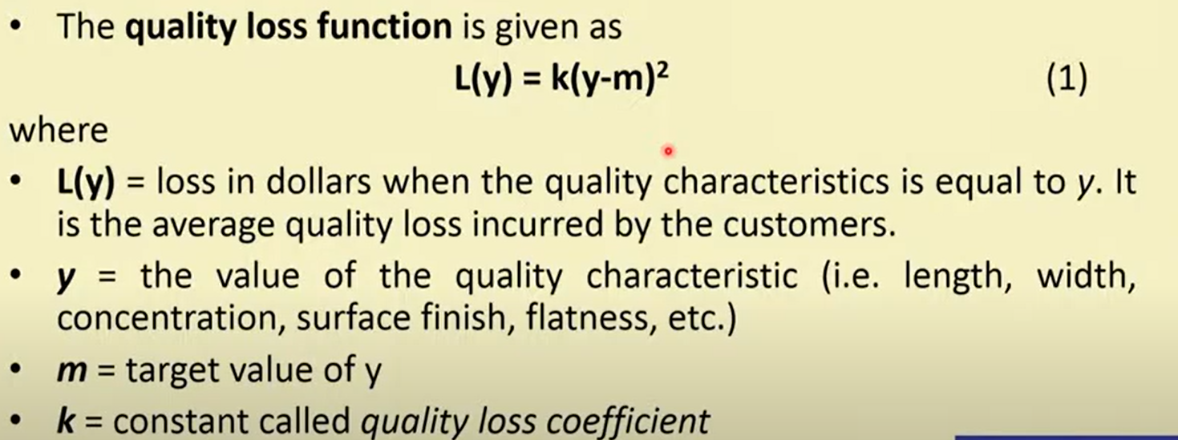
The Taguchi Quality Loss Function (QLF)
The loss is proportional to square of the deviation of y from the target value.
k is proportionality constant.

Slide 41
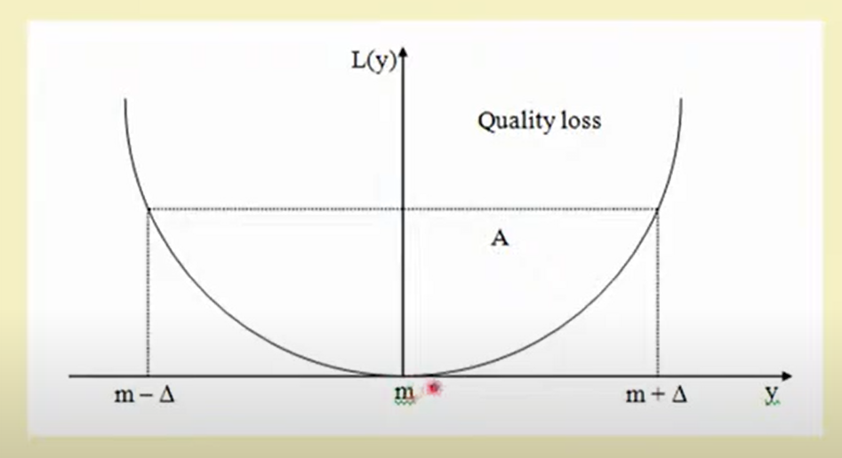
The Taguchi Quality Loss Function (QLF)

Slide 42
Quality Evaluations
According to the traditional concept of loss function that as long as the product’s quality characteristics is within the specification limits or tolerances, there are no losses incurred. The lose takes the form of a step function with a constant value A outside of the specification limits or tolerances.
The concept is simple but effective. Taguchi defines quality as “the total loss imparted to society from the time a product is shipped to the customer.”
Notes:
https://www.youtube.com/watch?v=ZS4vBrKMU5s

Slide 43
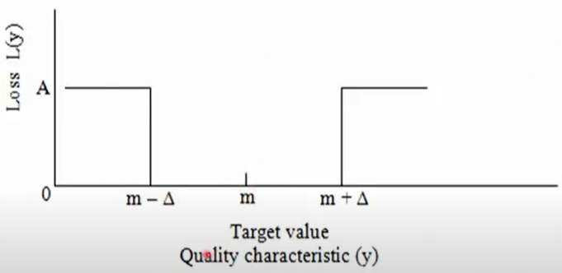
Quality Evaluations
Loss function L(y) makes no distinction between products
Whose quality characteristic is exactly on target at m, or
Whose quality characteristic is just above lower specification limit (LSL), or
Whose quality characteristics is just below the upper specification limit (USL)
The conventional method of computing the cost of quality is based on the number of parts rejected and reworked in a production environment. This method of quality evaluation is incapable of distinguishing between two samples, both within the specification limits but with different distributions of targeted properties.
Notes:
https://www.youtube.com/watch?v=ZS4vBrKMU5s

Slide 44
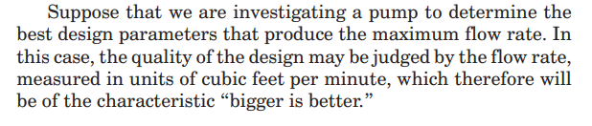
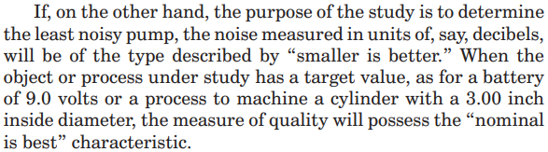
Quality Evaluations
It is also doubtful that the loss function L(y) remains constant at a value of A beyond the specification limits USL and LSL.
Since the Taguchi loss function increases quadratically with increasing deviation from the target value, the Taguchi loss function can be applied to three different situations or cases namely
Target is best (or) Nominal is best
Smaller is better
Larger is better
Target is best (or) Nominal is best
Larger is better
Smaller is better

Slide 45
Quality Evaluations (S/N Ratio)
Taguchi experiments often use a 2-step optimization process.
In step 1 use the signal-to-noise ratio to identify those control factors that reduce variability.
In step 2, identify control factors that move the mean to target and have a small or no effect on the signal-to-noise ratio.
Higher values of the signal-to-noise ratio (S/N) identify control factor settings that minimize the effects of the noise factors.
The signal-to-noise ratio measures how the response varies relative to the nominal or target value under different noise conditions. You can choose from different signal-to-noise ratios, depending on the goal of your experiment.
The important contribution of Taguchi is proposing the signal-to-noise (S/N) ratio. It was developed as a proactive equivalent to the reactive loss function.

Slide 46
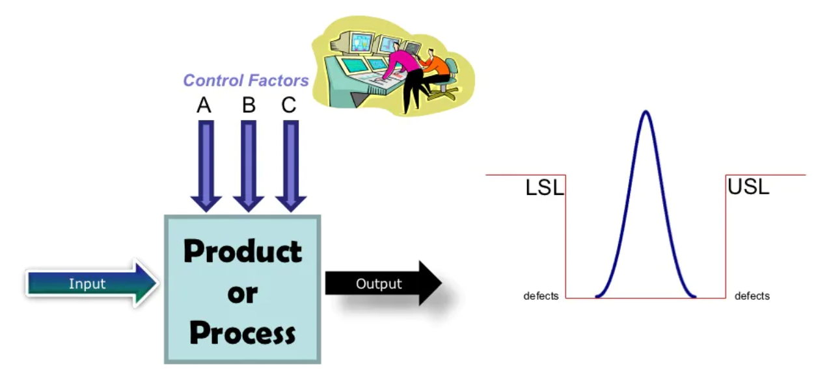
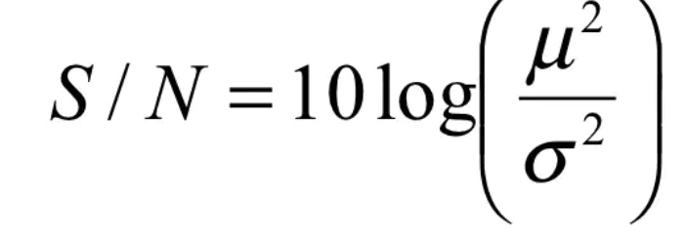
Quality Evaluations (S/N Ratio)
Mean
Standard Deviation or Variation
https://www.slideshare.net/rbalisnomo/Introduction-To-Taguchi-Method-05Sep08

Slide 47
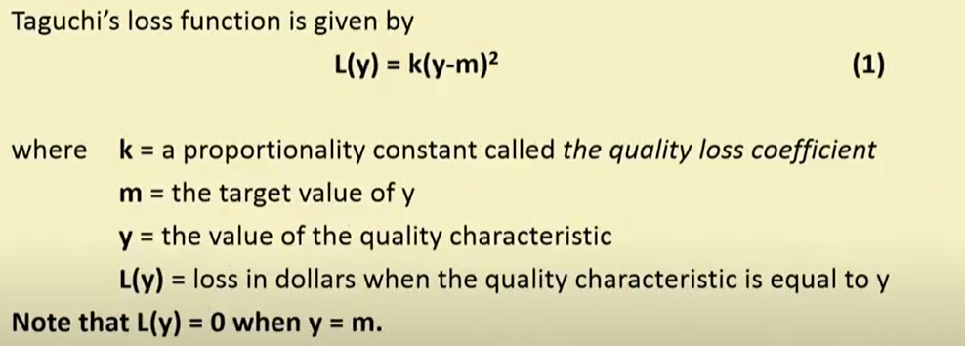
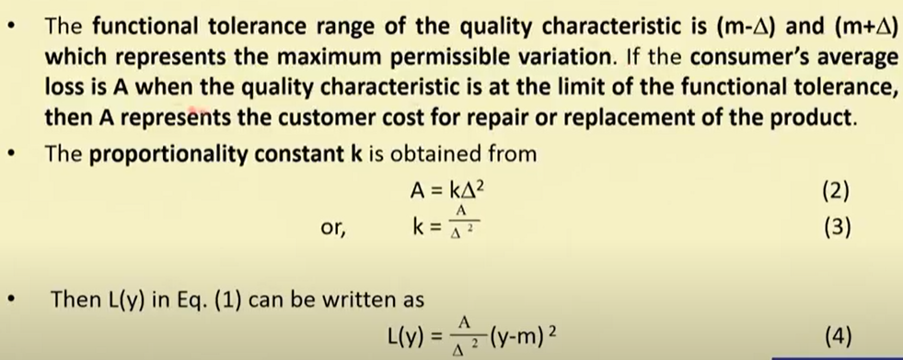
Quality Evaluations
Target is best or The Nominal-the-Best Case
Notes:
https://www.youtube.com/watch?v=ZS4vBrKMU5s

Slide 48
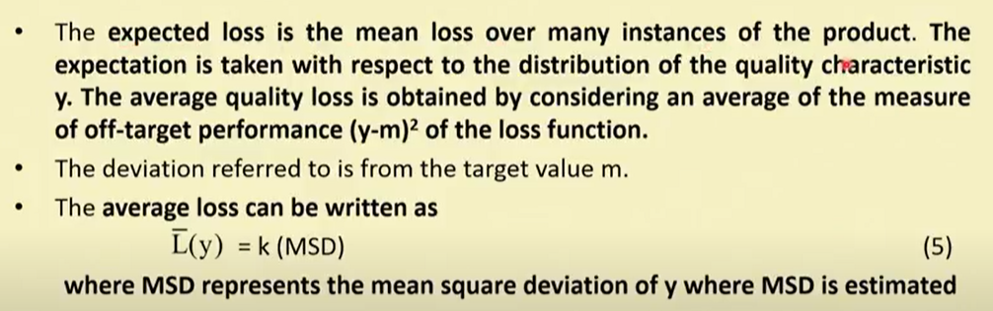
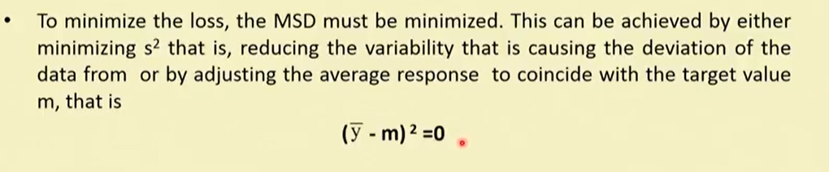
Quality Evaluations
Target is best or The Nominal-the-Best Case
Notes:
https://www.youtube.com/watch?v=ZS4vBrKMU5s

Slide 49
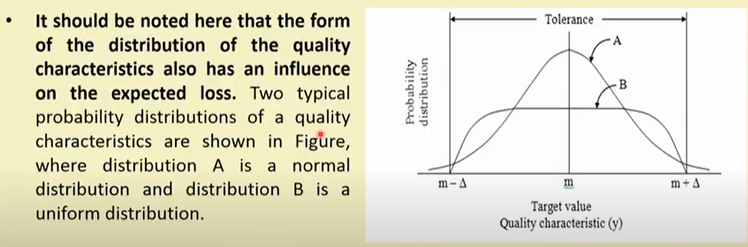
Quality Evaluations
Target is best or The Nominal-the-Best Case
Notes:
https://www.youtube.com/watch?v=ZS4vBrKMU5s

Slide 50
8-Steps in Taguchi Methodology
Choose control factors and their levels
Identify uncontrollable (noise) factors and decide on how they will be simulated.
Select the response variable(s) and determine the performance measures (mean, standard deviation, SNR, etc.)
Setup the experimental layout (choose appropriate design array (s))
Conduct the experiments and collect data
Analyze the data (effects, ANOVA, regression)
Choose optimal control factor levels and predict the performance measure at these levels
Confirm the optimal levels by experimentation.

Slide 51
Concept of ANOVA
• ANOVA (Analysis of Variance) is a statistical method used to analyze differences among group means.
• It helps determine if observed differences are statistically significant.
• Instead of comparing means pairwise (like in t-tests), ANOVA compares multiple means simultaneously.
• Commonly used in experimental design, such as Taguchi or DOE methods.

Slide 52
Purpose and Applications
• Identify factors that significantly affect a response variable.
• Partition total variation into components attributable to different sources.
• Widely used in:
- Engineering experiments
- Product design optimization
- Process control and improvement
- Agricultural and biological studies

Slide 53

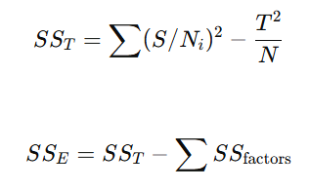
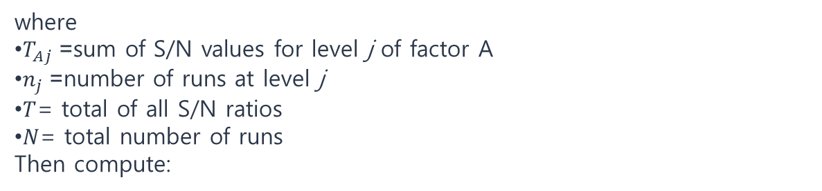
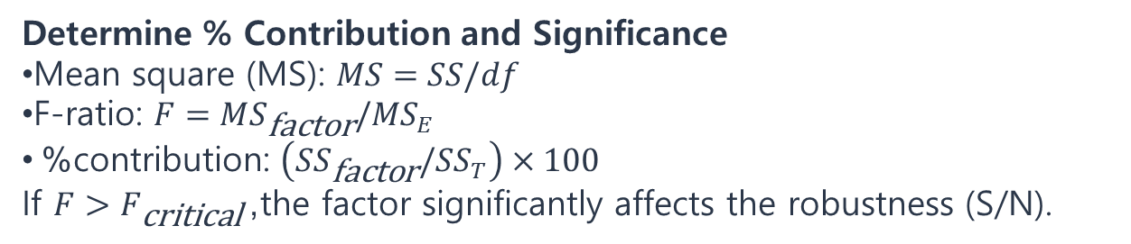
Perform ANOVA on the S/N Ratios
Compute Sum of Squares (SS) for each factor:
where
$T_{Aj}$= sum of S/N values for level j of factor A
$n_{j}$= number of runs at level j
$T$= total of all S/N ratios
$N$= total number of runs
Then compute:
Determine % Contribution and Significance
Mean square (MS): $MS=SS/df$
F-ratio: $F=MS_{\text{factor}}/MS_{E}$
% contribution: $\left(SS_{\text{factor}}/SS_{T}\right)×100$
If $F>F_{\text{critical}}$, the factor significantly affects the robustness (S/N).

Slide 54
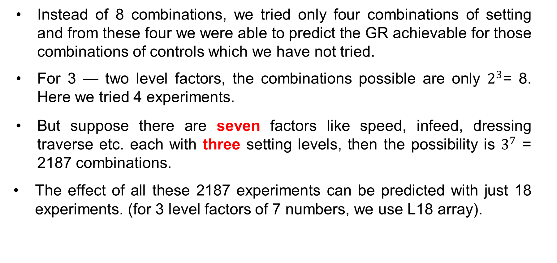
Taguchi Analysis (Example)
Instead of 8 combinations, we tried only four combinations of setting and from these four we were able to predict the GR achievable for those combinations of controls which we have not tried.
For 3 — two level factors, the combinations possible are only $2^{3}$= 8. Here we tried 4 experiments.
But suppose there are seven factors like speed, infeed, dressing traverse etc. each with three setting levels, then the possibility is $3^{7}$ = 2187 combinations.
The effect of all these 2187 experiments can be predicted with just 18 experiments. (for 3 level factors of 7 numbers, we use L18 array).

Slide 55
Taguchi Analysis (Orthogonal Array)
L8 (2^7) ORTHOGONAL ARRAY
Expt. No | Columns
 | 1 | 2 | 3 | 4 | 5 | 6 | 7
1 | 1 | 1 | 1 | 1 | 1 | 1 | 1
2 | 1 | 1 | 1 | 2 | 2 | 2 | 2
3 | 1 | 2 | 2 | 1 | 1 | 2 | 2
4 | 1 | 2 | 2 | 2 | 2 | 1 | 1
5 | 2 | 1 | 2 | 1 | 2 | 1 | 2
6 | 2 | 1 | 2 | 2 | 1 | 2 | 1
7 | 2 | 2 | 1 | 1 | 2 | 2 | 1
8 | 2 | 2 | 1 | 2 | 1 | 1 | 2
L9 (3^4) ORTHOGONAL ARRAY
Expt.No | Columns
 | 1 | 2 | 3 | 4
1 | 1 | 1 | 1 | 1
2 | 1 | 2 | 2 | 2
3 | 1 | 3 | 3 | 3
4 | 2 | 1 | 2 | 3
5 | 2 | 2 | 3 | 1
6 | 2 | 3 | 1 | 2
7 | 3 | 1 | 3 | 2
8 | 3 | 2 | 1 | 3
9 | 3 | 3 | 2 | 1

Slide 56
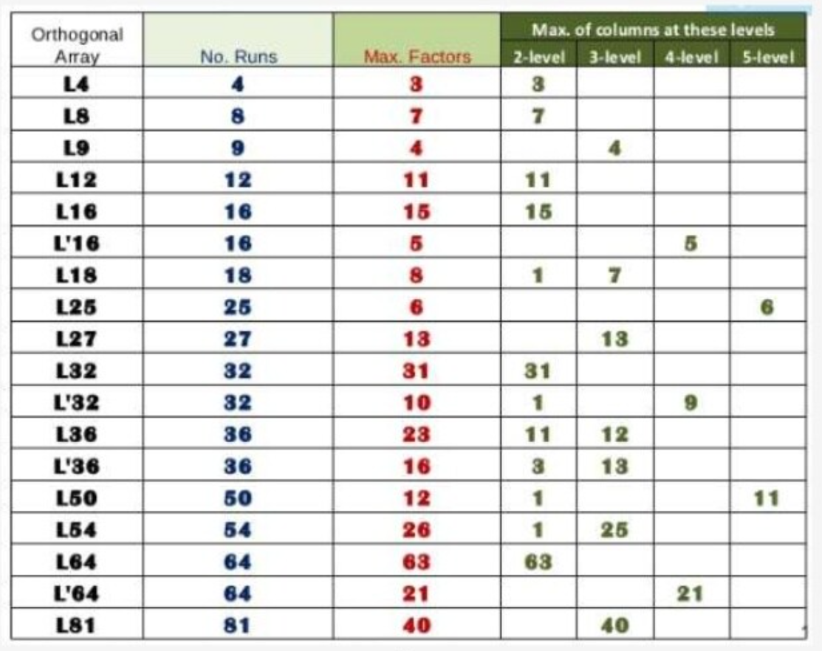
Taguchi Analysis (Orthogonal Array)

Slide 57
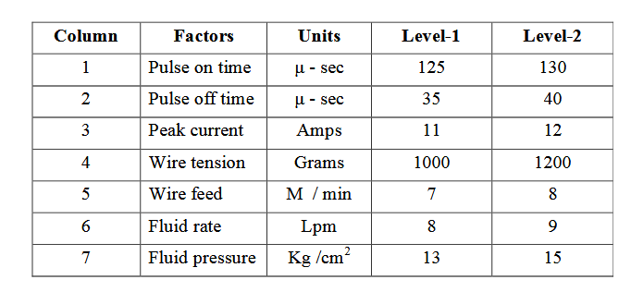
Taguchi Analysis (Example Problem)
The objective of the experiment is to obtain minimum surface roughness of the parts machined by wire cut EDM machine using Taguchi’s DOE technique of process parameters.
Surface roughness(Ra) values were obtained using Taylor-Hobson Surtronic instruments and the sequence are 2.5275, 2.3520, 2.2540, 2.4650, 2.7000, 2.8125, 2.350, 2.2875.
Find out the Main effect and draw the factor effect diagram and identify the optimum WEDM process parameters.

Slide 58
Taguchi Analysis (Example Problem)
Since, the number of factors given are 7 with 2 levels. Hence, we can choose L8 orthogonal array.
Expt. No | Columns
 | 1 | 2 | 3 | 4 | 5 | 6 | 7
1 | 1 | 1 | 1 | 1 | 1 | 1 | 1
2 | 1 | 1 | 1 | 2 | 2 | 2 | 2
3 | 1 | 2 | 2 | 1 | 1 | 2 | 2
4 | 1 | 2 | 2 | 2 | 2 | 1 | 1
5 | 2 | 1 | 2 | 1 | 2 | 1 | 2
6 | 2 | 1 | 2 | 2 | 1 | 2 | 1
7 | 2 | 2 | 1 | 1 | 2 | 2 | 1
8 | 2 | 2 | 1 | 2 | 1 | 1 | 2

Slide 59
Taguchi Analysis (Example Problem)
L8 orthogonal array.
Smaller-the-Better: η = -10 log10( $y^{2}$)
Hence solving for η
Expt. No | Columns |  |  |  |  |  |  | Surface Roughness (y) | η
 | Pull on Timet (A) | Pulse off time (B) | Peak Current(C) | Wire Tension (D) | Wire Feed (E) | Fluid Rate (F) | Fluid Pressure (G)
1 | 125 (1) | 35 (1) | 11 (1) | 1000 (1) | 7 (1) | 8 (1) | 13 (1) | 2.5275 |  | η1
2 | 125 (1) | 35 (1) | 11 (1) | 1200 (2) | 8 (2) | 9 (2) | 15 (2) | 2.3520 |  | η2
3 | 125 (1) | 40 (2) | 12 (2) | 1000 (1) | 7 (1) | 9 (2) | 15 (2) | 2.2540 |  | η3
4 | 125 (1) | 40 (2) | 12 (2) | 1200 (2) | 8 (2) | 8 (1) | 13 (1) | 2.4650 |  | η4
5 | 130 (2) | 35 (1) | 12 (2) | 1000 (1) | 8 (2) | 8 (1) | 15 (2) | 2.7000 |  | η5
6 | 130 (2) | 35 (1) | 12 (2) | 1200 (2) | 7 (1) | 9 (2) | 13 (1) | 2.8125 |  | η6
7 | 130 (2) | 40 (2) | 11 (1) | 1000 (1) | 8 (2) | 9 (2) | 13 (1) | 2.350 |  | η7
8 | 130 (2) | 40 (2) | 11 (1) | 1200 (2) | 7 (1) | 8 (1) | 15 (2) | 2.2875 |  | η8
 |  |  |  |  |  |  |  | µ

Slide 60
Taguchi Analysis (Example Problem)
L8 orthogonal array.
Smaller-the-Better: η = -10 log10( $y^{2}$)
Hence solving for η
Expt. No | Columns |  |  |  |  |  |  | Surface Roughness (y) | η
 | Peak current (A) | Pulse on time (B) | Peak Current(C) | Wire Tension (D) | Wire Feed (E) | Fluid Rate (F) | Fluid Pressure (G)
1 | 125 (1) | 35 (1) | 11 (1) | 1000 (1) | 7 (1) | 8 (1) | 13 (1) | 2.5275 | -8.053823285 | η1
2 | 125 (1) | 35 (1) | 11 (1) | 1200 (2) | 8 (2) | 9 (2) | 15 (2) | 2.3520 | -7.428746348 | η2
3 | 125 (1) | 40 (2) | 12 (2) | 1000 (1) | 7 (1) | 9 (2) | 15 (2) | 2.2540 | -7.059078234 | η3
4 | 125 (1) | 40 (2) | 12 (2) | 1200 (2) | 8 (2) | 8 (1) | 13 (1) | 2.4650 | -7.836338472 | η4
5 | 130 (2) | 35 (1) | 12 (2) | 1000 (1) | 8 (2) | 8 (1) | 15 (2) | 2.7000 | -8.627275283 | η5
6 | 130 (2) | 35 (1) | 12 (2) | 1200 (2) | 7 (1) | 9 (2) | 13 (1) | 2.8125 | -8.981850622 | η6
7 | 130 (2) | 40 (2) | 11 (1) | 1000 (1) | 8 (2) | 9 (2) | 13 (1) | 2.350 | -7.421357245 | η7
8 | 130 (2) | 40 (2) | 11 (1) | 1200 (2) | 7 (1) | 8 (1) | 15 (2) | 2.2875 | -7.187222055 | η8
 |  |  |  |  |  |  |  | µ | -7.82446144

Slide 61
Taguchi Analysis (Example Problem)
Determine the factor effects
mA₁ =1/4 (η₁ + η₂ + η₃ + η₄) = 0.25 * (-8.053-7.428-7.059-7.836) = -7.5945
mA₂ =1/4 (η₅ + η₆ + η₇ + η₈) = 0.25 * (-8.627-8.981-7.42-7.187) = -8.053
mB₁ =1/4 (η₁ + η₂ + η₅ + η₆) =
mB₂ =1/4 (η₃ + η₄ + η₇ + η₈) =
mC₁ =
mC₂ =
mD₁ =
mD₂ =
mE₁ =
mE₂ =
mF₁ =
mF₂ =
mG₁ =
mG₂ =

Slide 62
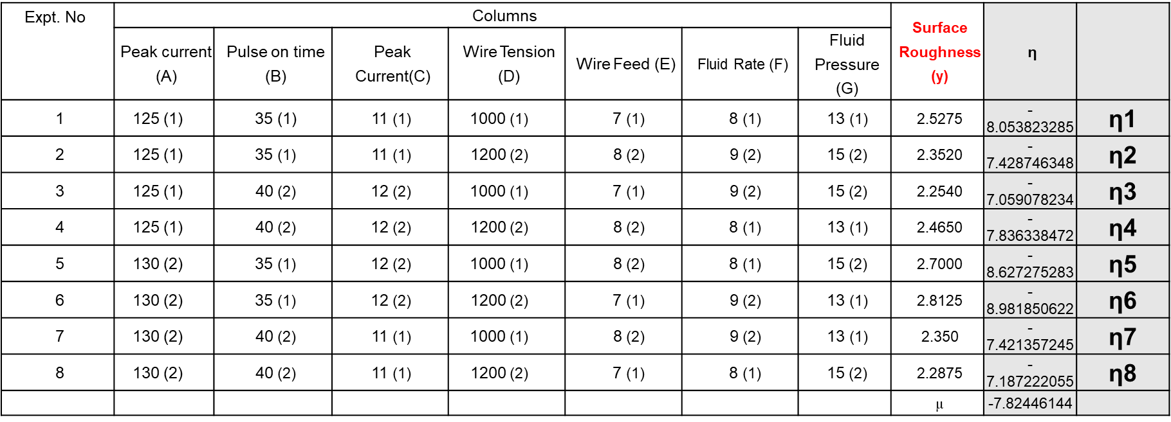
Taguchi Analysis (Example Problem)
Determine the factor effects
mA₁ =1/4 (η₁ + η₂ + η₃ + η₄) = 0.25 * (-8.053-7.428-7.059-7.836) = -7.5945
mA₂ =1/4 (η₅ + η₆ + η₇ + η₈) = 0.25 * (-8.627-8.981-7.42-7.187) = -8.053
mB₁ =1/4 (η₁ + η₂ + η₅ + η₆) = -8.272
mB₂ =1/4 (η₃ + η₄ + η₇ + η₈) = -7.37
mC₁ =1/4 (η₁ + η₂ + η₇ + η₈) = -7.522
mC₂ =1/4 (η₃ + η₄ + η₅ + η₆) = -8.125
mD₁ =1/4 (η₁ + η₃ + η₅ + η₇) = -7.789
mD₂ =1/4 (η₂ + η₄ + η₆ + η₈) = -7.858
mE₁ =1/4 (η₁ + η₃ + η₆ + η₈) = -7.82
mE₂ =1/4 (η₂ + η₄ + η₅ + η₇) = -7.827
mF₁ =1/4 (η₁ + η₄ + η₅ + η₈) = -7.925
mF₂ =1/4 (η₂ + η₃ + η₆ + η₇) = -7.722
mG₁ =1/4 (η₁ + η₄ + η₆ + η₇) = -8.072
mG₂ =1/4 (η₂ + η₃ + η₅ + η₈) = -7.575

Slide 63
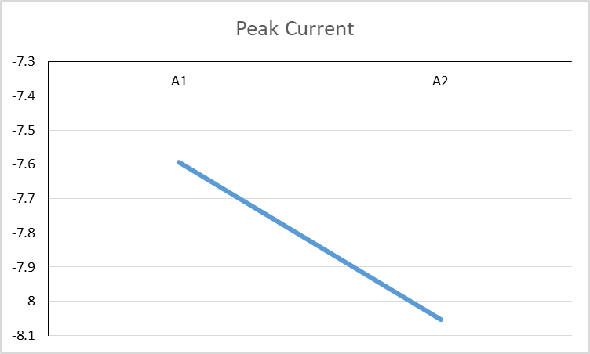
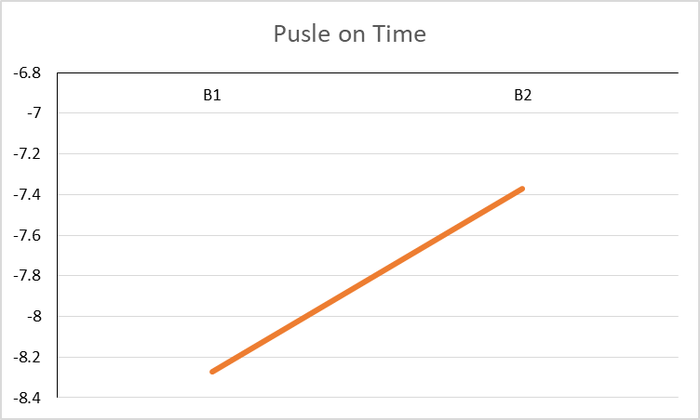
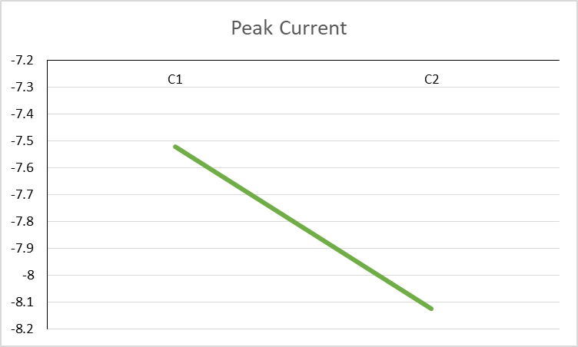
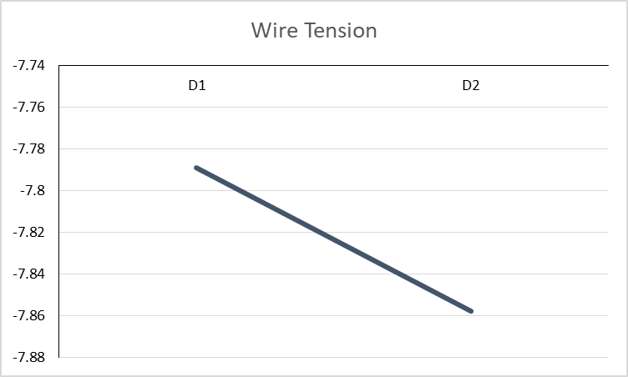
Taguchi Analysis (Example Problem)
Determine the factor effects (graph)

Slide 64
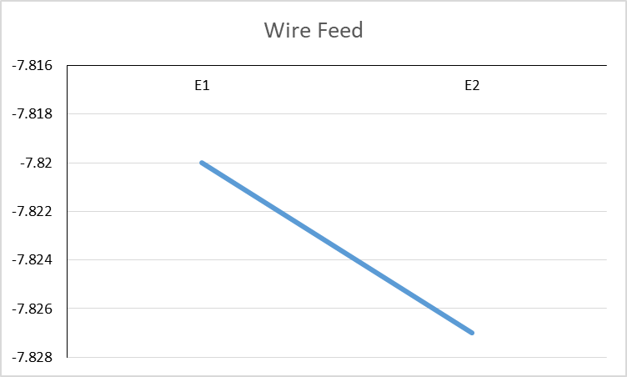
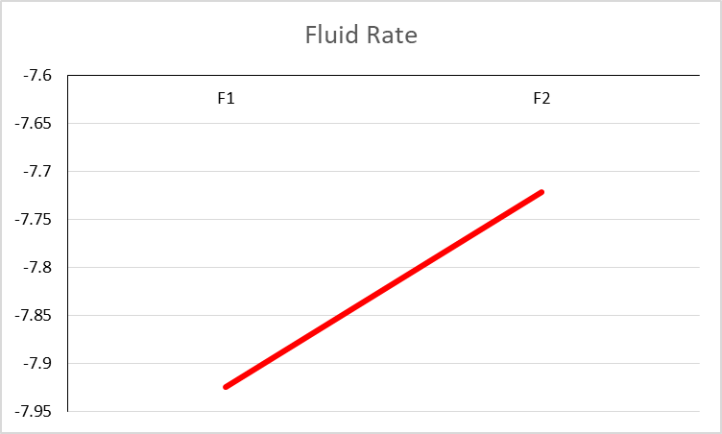
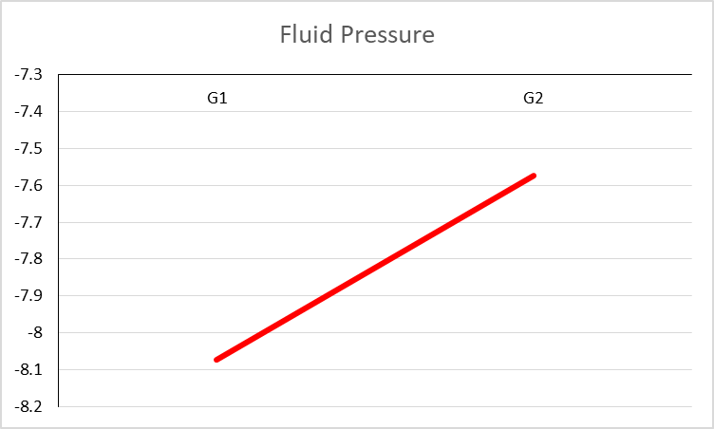
Taguchi Analysis (Example Problem)
Determine the factor effects (graph)

Slide 65
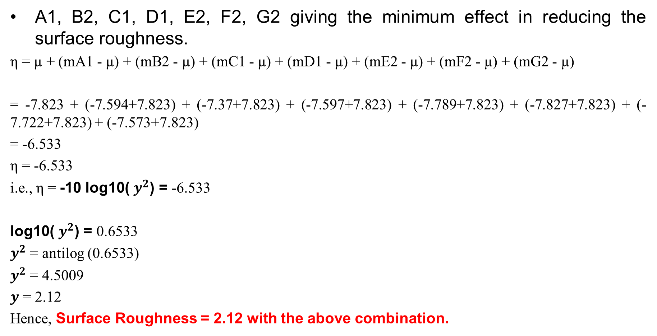
Taguchi Analysis (Example Problem)
A1, B2, C1, D1, E2, F2, G2 giving the minimum effect in reducing the surface roughness.
η = µ + (mA1 - µ) + (mB2 - µ) + (mC1 - µ) + (mD1 - µ) + (mE2 - µ) + (mF2 - µ) + (mG2 - µ)
= -7.823 + (-7.594+7.823) + (-7.37+7.823) + (-7.597+7.823) + (-7.789+7.823) + (-7.827+7.823) + (-7.722+7.823) + (-7.573+7.823)
= -6.533
η = -6.533
i.e., η = -10 log10( $y^{2}$) = -6.533
log10( $y^{2}$) = 0.6533
$y^{2}$ = antilog (0.6533)
$y^{2}$ = 4.5009
$y$ = 2.12
Hence, Surface Roughness = 2.12 with the above combination.

Slide 66
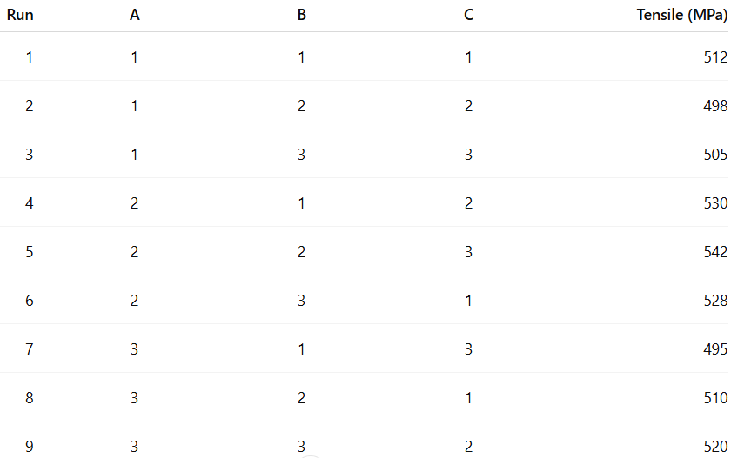
Another problem:
A materials lab wants to maximize tensile strength (MPa) of an alloy. They use an L₉ orthogonal array with three factors (A, B, C), each at 3 levels. The measured tensile strengths for the nine runs are:
Use the larger-the-better S/N ratio to determine the best level of each factor (A, B, C).
Perform an ANOVA on the S/N ratios to estimate the percentage contribution of each factor.
Recommend the optimal factor-level combination and state why.

Slide 67
Solution Hints:
S/N formula (larger-the-better) For each run with response yᵢ, the signal-to-noise ratio is: S/N = -10 × log₁₀( (1/n) Σ(1/yᵢ²) ) Since there is one observation per run, S/Nᵢ = 20 × log₁₀(yᵢ). Example: For Run 1, y₁ = 512 → S/N₁ = 20 × log₁₀(512) ≈ 54.185 dB.
Compute level means of S/N: For each factor and level, average the S/N of runs at that level (3 runs per level). Example: for factor A level 1, average the S/N of runs 1–3. The level with the highest mean S/N gives the optimal setting for that factor.
ANOVA on S/N values: - Total Sum of Squares (SST) = Σ(S/Nᵢ²) - (ΣS/Nᵢ)² / N - For each factor (e.g., A): SS_A = Σ(T_Aj² / n_j) - (ΣS/Nᵢ)² / N where T_Aj is the sum of S/Ns for runs where A = level j, and n_j = 3. - Compute SS_B and SS_C similarly. - Error SS (if replicates are absent): SS_E = SST - (SS_A + SS_B + SS_C). If no pure error is available, you may pool the smallest factor’s SS as the error term.
Percentage contribution: %Contribution_A = (SS_A / SST) × 100% %Contribution_B = (SS_B / SST) × 100% %Contribution_C = (SS_C / SST) × 100%.
Recommendation: Choose the combination of A, B, and C that gives the highest S/N mean levels. This combination represents the optimal parameter settings for maximum tensile strength.

Slide 68
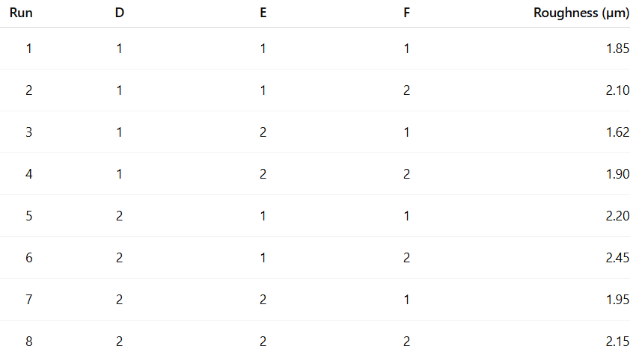
Another one:
A machining team wants to minimize surface roughness (µm). They use an L₈ (two-level) array with three factors: D (cutting speed), E (feed), and F (depth of cut). Each factor has two levels (1 = low, 2 = high). The measured roughness values are:
Using the smaller-the-better S/N ratio, identify the best level for D, E, and F.
Using S/N ANOVA (or percent contribution), determine which factor most affects roughness.
Predict the expected roughness at the optimal setting using the additive model.

Slide 69
Solution hint:
S/N formula (smaller-the-better): For each run: S/N = -10 × log₁₀( (1/n) Σ(yᵢ²) ). For a single measurement, S/Nᵢ = -20 × log₁₀(yᵢ). Example: Run 1, y₁ = 1.85 → S/N₁ = -20 × log₁₀(1.85).
Level means of S/N: Compute average S/N for each level of D, E, and F (4 runs per level). Select the level with the higher S/N as optimal (since higher S/N corresponds to lower roughness for smaller-the-better).
ANOVA on S/N: - Compute SST = Σ(S/Nᵢ²) - (ΣS/Nᵢ)² / 8. - For each factor, compute SS = Σ(T_j² / n_j) - (ΣS/Nᵢ)² / 8, where n_j = 4. - Calculate % contribution = (SS_factor / SST) × 100%.
Predict expected roughness: Use the Taguchi additive model: ŷ = overall mean + (effect of D at optimal level) + (effect of E at optimal level) + (effect of F at optimal level). Here, each effect = mean at that level − overall mean. The optimal combination corresponds to the highest S/N and lowest predicted roughness.
Practical note: As no replicates are included in the L₈ design, the pure error cannot be estimated directly. Pooling negligible factor effects as error or performing confirmation runs is recommended.

Slide 70
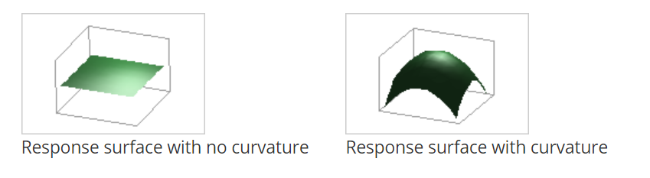
Response Surface Design
A response surface design is a set of advanced design of experiments (DOE) techniques that help you better understand and optimize your response. Response surface design methodology is often used to refine models after you have determined important factors using screening designs or factorial designs; especially if you suspect curvature in the response surface.
Notes:
https://www.youtube.com/watch?v=O0NF4tKe5lM&t=3s

Slide 71
Background of response surface design
Response Surface Methodology, or RSM, is a collection of mathematical and statistical techniques useful for the modeling and analysis of problems in which a response of interest is influenced by several variables and the objective is to optimize this response.
Xi
Process/System
Response (Ex: Process yield, defects, etc.)
Zi
Setting the X in the particular range or zone by that we can able to get the optimal response value.
Notes:
https://www.youtube.com/watch?v=O0NF4tKe5lM&t=3s

Slide 72
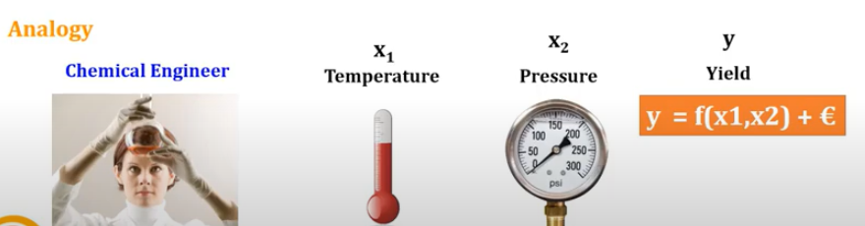
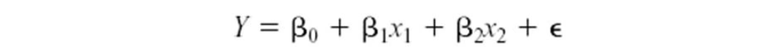
Background of response surface design
RSM, is a collection of mathematical and statistical techniques useful for the developing, improving, and optimizing processes.
Notes:
https://www.youtube.com/watch?v=O0NF4tKe5lM&t=3s

Slide 73
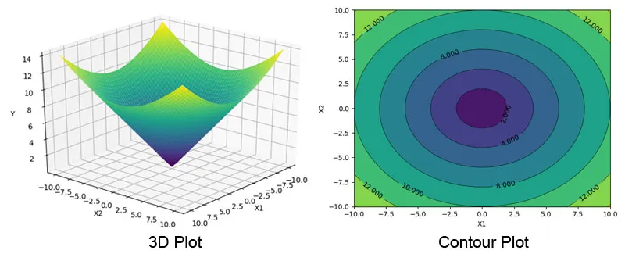
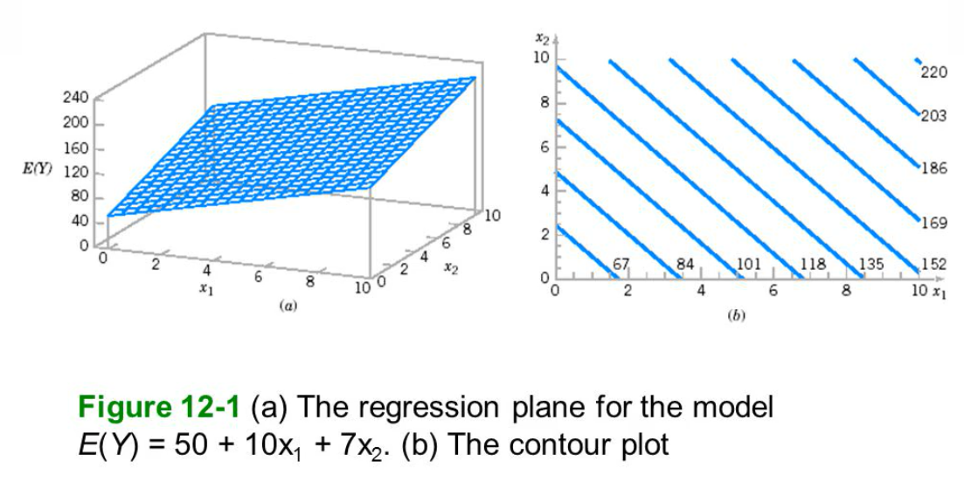
Background of response surface design
Notes:
https://www.youtube.com/watch?v=O0NF4tKe5lM&t=3s

Slide 74
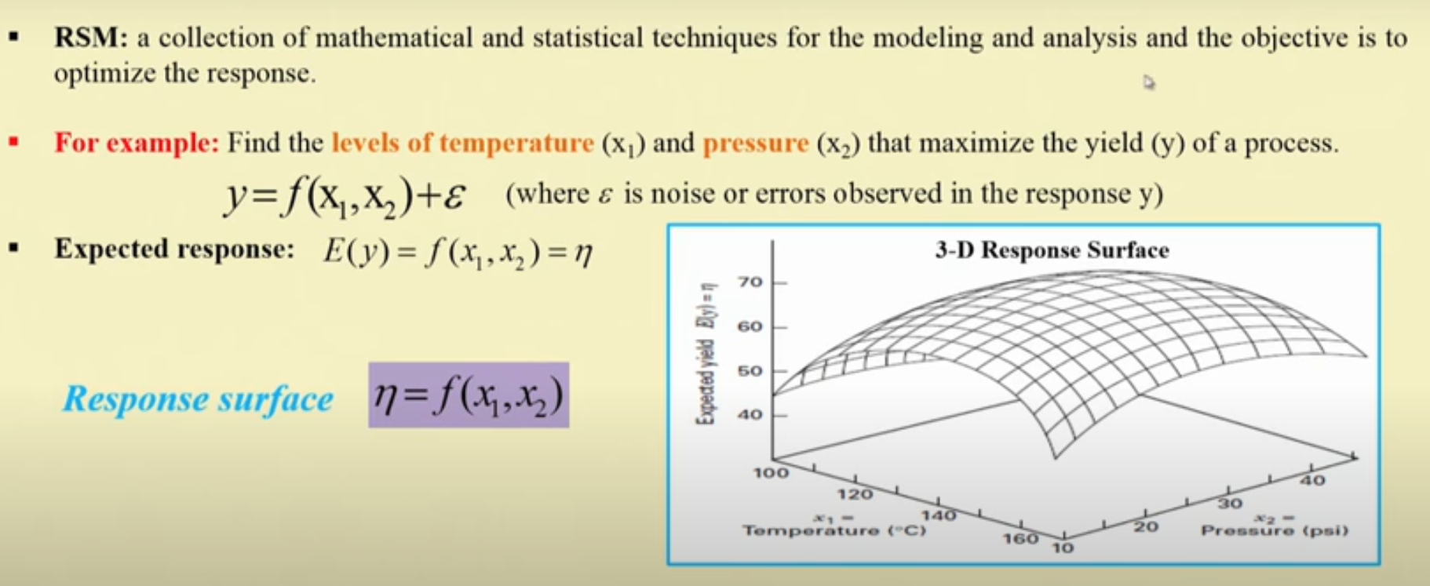
Background of response surface design
Notes:
https://www.youtube.com/watch?v=O0NF4tKe5lM&t=3s

Slide 75
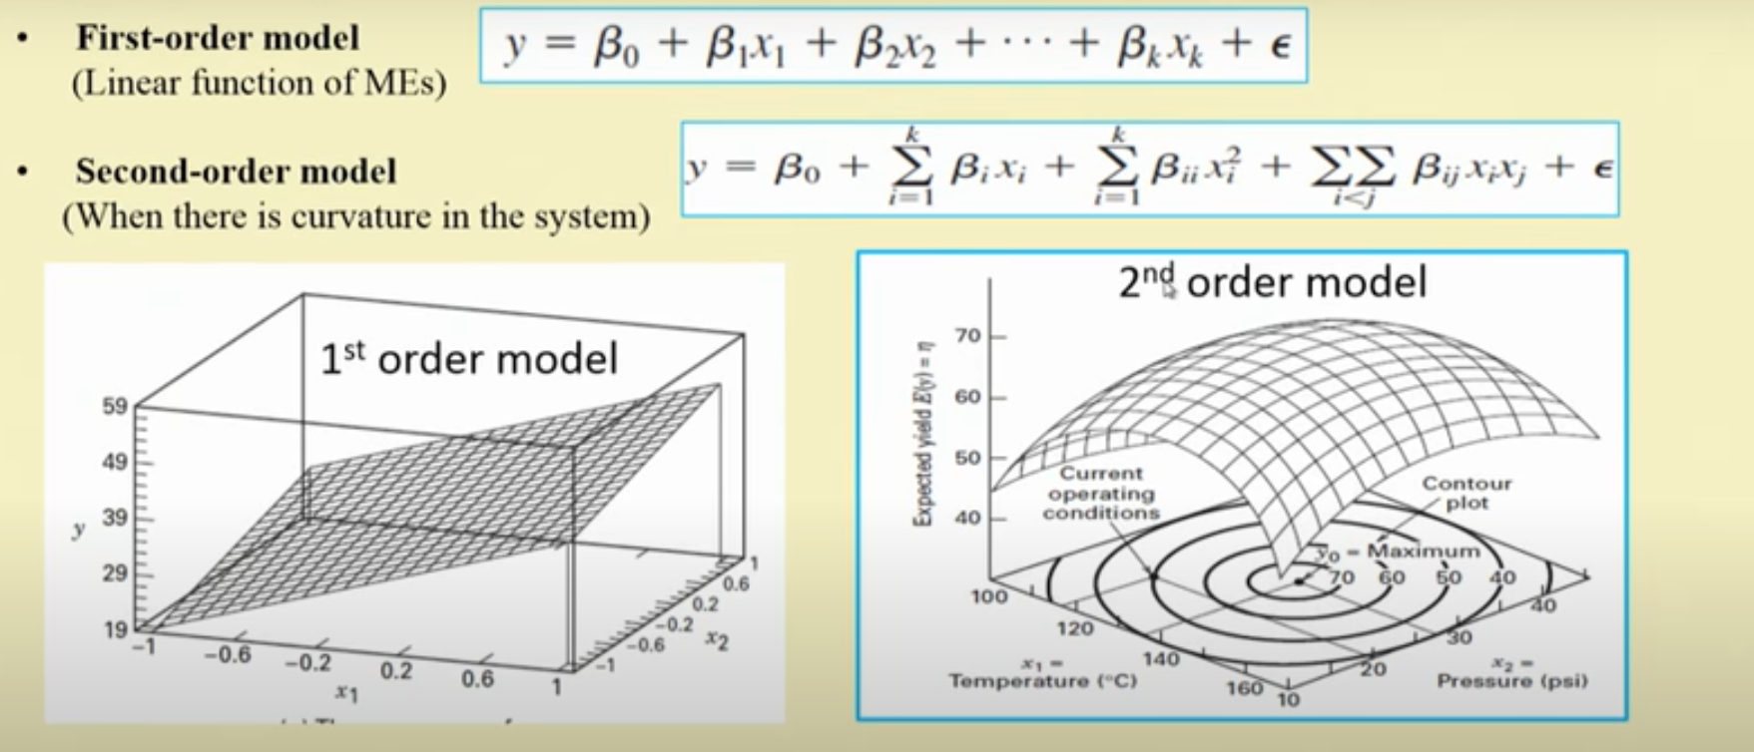
Background of response surface design
Notes:
https://www.youtube.com/watch?v=O0NF4tKe5lM&t=3s

Slide 76
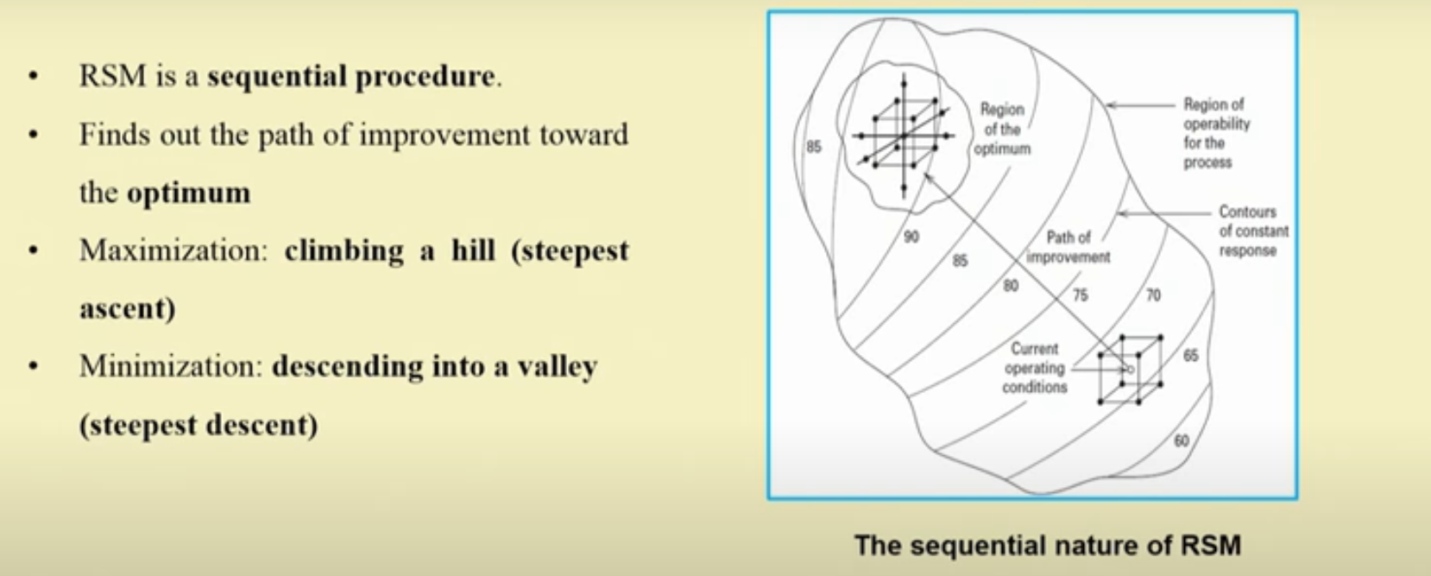
Background of response surface design
Notes:
https://www.youtube.com/watch?v=O0NF4tKe5lM&t=3s

Slide 77
Background of response surface design
The difference between a response surface equation and the equation for a factorial design is the addition of the squared (or quadratic) terms that lets you model curvature in the response, making them useful for:
Understanding or mapping a region of a response surface. Response surface equations model how changes in variables affect a response of interest.
Finding the levels of variables that optimize a response.
Selecting the operating conditions to meet specifications.
For example, you would like to determine the best conditions for injection-molding a plastic part. You first used a screening or factorial experiment to determine the significant factors (temperature, pressure, cooling rate). You can use a response surface designed experiment to determine the optimal settings for each factor.
Notes:
https://www.youtube.com/watch?v=O0NF4tKe5lM&t=3s

Slide 78
Background of response surface design
The difference between a response surface equation and the equation for a factorial design
A two-level factorial (or fractional factorial) design looks for linear trends, possibly with interactions
Does the variable significantly impact the response? In what direction?
It helps to define the next experiment.
Response Surface Methodology (RSM) looks for quadratic or higher order trends
Assumes all variable are significant
A quadratic response always has a stationary point (minimum or maximum or saddle point)
Can be used to optimize a process
Notes:
https://www.youtube.com/watch?v=O0NF4tKe5lM&t=3s

Slide 79
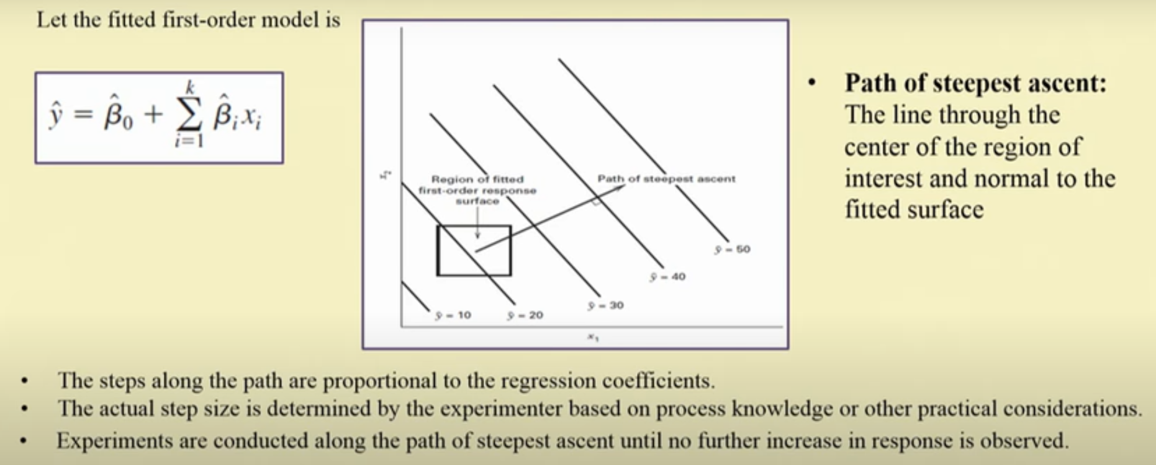
Background of response surface design
The Method of Steepest Ascent
Notes:
https://www.youtube.com/watch?v=O0NF4tKe5lM&t=3s

Slide 80
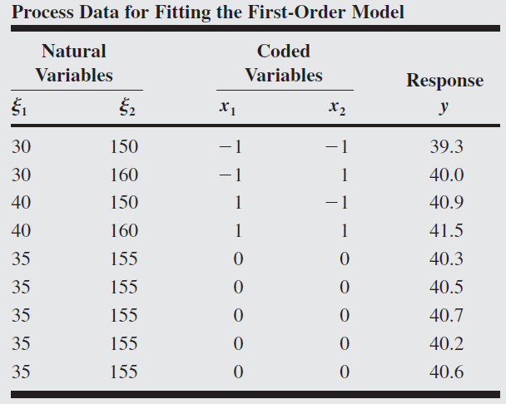
Example 1 (First-order RSM)
A chemical engineer is interested in determining the operating conditions that maximize the yield of a process. Two controllable variables influence process yield: reaction time and reaction temperature. The engineer is currently operating the process with a reaction time of 35 minutes and a temperature of 155°F, which result in yields of around 40 percent. Because it is unlikely that this region contains the optimum, she fits a first-order model and applies the method of steepest ascent.

Slide 81
Example 1 (RSM First-order Model)
Response variable = Process yield = Y = 40%
Current operating condition:
Natural variable ${(ε}_{1}$) = Coded variable (X1) = Reaction time of 35 minutes
Natural variable ${(ε}_{2}$) = Coded variable (X2) = Temperature of 155°F
2^{K} factorial design with center point
X1: High = 40 min (+1); Low = 30 min (-1)
X2: High = 160 F (+1); Low = 150 F (-1)
X2
160
Temp
(35, 155)
150
30
40
Time
X1

Slide 82
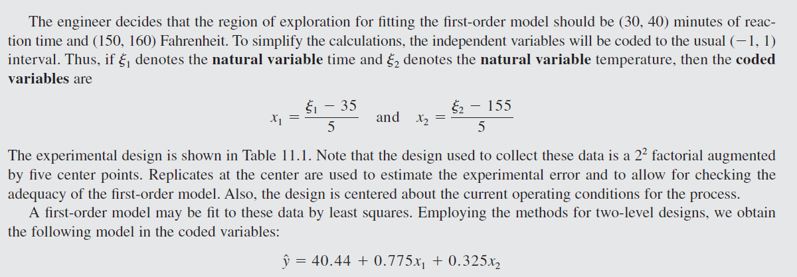



Example 1 (First-order RSM)
Y=$β_{0}$+$β_{1}X_{1}$+$β_{2}X_{2}$
40.44 = Average of all Y observation ($β_{0}$)…
$β_{1 }= \frac{1}{2}(Effect of X1)$ =$\frac{1}{2}(\left(\frac{40.9+41.5}{2}\right)−(\frac{39.3+40.0}{2}))$ = 0.775
$β_{2 }= \frac{1}{2}(Effect of X2)$ = $\frac{1}{2}(\left(\frac{40+41.5}{2}\right)−(\frac{39.3+40.9}{2}))$ = 0.325

Slide 83

Example 1 (First-order RSM)
In order to check, whether the first-order model fitted or not, we have to check the following:
Estimate the Error (based on central point observation)
Test for Interaction ($\hat{y}= β_{0}+β_{1}x_{1}+β_{2}x_{2}+β_{12}x_{1}x_{2})$ whether $β_{12}$ significant or not?
Test for Quadratic effects ($\hat{y}= β_{0}+β_{1}x_{1}+β_{2}x_{2}+β_{12}x_{1}x_{2}+β_{11}^{}x_{1}^{2}+β_{22}^{}x_{2}^{2})$ whether $β_{11}^{}+β_{22}^{}$ significant or not?
If step 2 and step 3 is equal to zero, then we can say the first-order model is fit. If not, we have to analysis further.

Slide 84
Example 1 (First-order RSM)
Step 1. Estimate the Error (based on central point observation)
Error = [Sum of square of all the values/responses – (squares of sum of all the values)/n] / n-1
The mean square Error (MS_{E}) = 0.0430

Slide 85

Example 1 (First-order RSM)
Step 2. Test for Interaction Estimate the Error
The first-order model assumes that the variables x1 and x2 have an additive effect on the response. The interaction between the variables would be represented by the coefficient of $β_{12}$ of a cross-product term x1x2 added to the model.
The least squares estimate of this coefficient is just one-half the interaction effect calculated as in an ordinary 2² factorial design,

Slide 86

Example 1 (First-order RSM)
Step 2. Test for Interaction Estimate the Error
Test for Interaction ($\hat{y}= β_{0}+β_{1}x_{1}+β_{2}x_{2}+β_{12}x_{1}x_{2})$ whether $β_{12}$ significant or not?
So, Hypothesis H0 = $β_{12}$ = 0
Alternative H1 = $β_{12}$ ≠ 0
$β_{12}$ can be estimated from factorial points.
So Interaction = $\frac{1}{2}[$Average of (39.3+41.5) – Average of (40+40.9)] = - 0.025
(or)
AB = $\frac{1}{2}($41.5+39.3-40.9-40]
Hence, Interaction = AB/2 = $\frac{1}{4}($41.5+39.3-40.9-40] = -0.025
40
41.5
39.3
40.9

Slide 87

Example 1 (First-order RSM)
Step 2. Test for Interaction Estimate the Error
Test for Interaction ($\hat{y}= β_{0}+β_{1}x_{1}+β_{2}x_{2}+β_{12}x_{1}x_{2})$ whether $β_{12}$ significant or not?
Hence, Interaction = -0.025 with DOF = 1
MS_{E} = 0.0430 with DOF = 4
We have to know interaction is significant or not, hence, compare the interaction value with MS_{E}
F = $\frac{{(SS}_{x_{1}x_{2}/DOF)}}{{MS}_{E}}=\frac{\frac{{\left(−0.1\right)}^{2}}{4}}{0.0430}=0.058$…which is small and insignificant or negligible.

Slide 88



Example 1 (First-order RSM)
Step 3: Test for Quadratic effects whether $β_{11}^{}+β_{22}^{}$ significant or not?
whether $β_{11}^{}+β_{22}^{}=YF −YC$
= 40.425 – 40.46 = -0.035
Hypothesis H0 = ${β_{11}+β}_{22}$ = 0
Alternative H1 =${β_{11}+β}_{22}$≠ 0
$0.063$…which is small, hence, there is no indication of a pure quadratic effect.
Factorial portion
Factorial portion
Center point
Factorial portion
Factorial portion
So, quadratic effect not there…interaction effect not there…hence, the first-order model is fit one.

Slide 89

Example 1 (First-order RSM)

Slide 90


Example 1 (First-order RSM)
Hence, we can say $\hat{y}= β_{0}+β_{1}x_{1}+β_{2}x_{2}$ is fit one…..
However, we need to ensure whether the parameters $β_{1}$ and$β_{2}$ is significant….by doing Test of Parameter Estimates..
For that, we need to identify the variance of $β_{i}$….i.e., V($β_{i}$)
V($β_{i}$) = $\frac{{MS}_{E}}{4}$
SE($β_{i}$) = $\sqrt{\frac{{MS}_{E}}{4}}$=$\sqrt{\frac{0.0430}{4}}=0.1$
Both regression coefficients and are large relative to their standard errors. At this point, we have no reason to question the adequacy of the first-order model.

Slide 91


Example 1 (First-order RSM)
X2 (Temp)
Center point (0,0)
X1 (Time)

Slide 92

Example 1 (First-order RSM)
180
85, 175
170
160
80
90
35, 155
150
30
40

Slide 93




Example 1 (First-order RSM)
78.97 = Average of all Y observation ($β_{0}$)…
$β_{1 }= \frac{1}{2}(Effect of X1)$ =$\frac{1}{2}(\left(\frac{78+79.5}{2}\right)−(\frac{76.5+77}{2}))$ = 1
$β_{2 }= \frac{1}{2}(Effect of X2)$ = $\frac{1}{2}(\left(\frac{77+79.5}{2}\right)−(\frac{376.5+78}{2}))$ = 0.5

Slide 94


Example 1 (First-order RSM)

Slide 95

Analysis of a Second-Order Response Surface

Slide 96


Analysis of a Second-Order Response Surface

Slide 97

Analysis of a Second-Order Response Surface

Slide 98

Analysis of a Second-Order Response Surface

Slide 99

Analysis of a Second-Order Response Surface

Slide 100

Analysis of a Second-Order Response Surface

Slide 101

Features for selecting response surface design

Slide 102

Example.
Response surface for certain manufacturing process was defined by the given equation($Z=17x_{1}+27x_{2}−x_{1}^{2}−0.9x_{2}^{2}$). Determine the approximate optimum operating point using the method of steepest ascent. The starting point of research should be x₁=2 and x₂=3 and step size C=4.
$$Z=17x_{1}+27x_{2}−x_{1}^{2}−0.9x_{2}^{2}$$
Step size = 4.0
$$x_{1}=2;x_{2}=3$$
$Z(2,3)=17x_{1}+27x_{2}−x_{1}^{2}−0.9x_{2}^{2}$ = $17(2)+27(3)−2_{}^{2}−0.9{(3}_{}^{2})=102.9$
$$Gradient ofx_{1}=G1.P. = \frac{∂z}{∂x_{1}}=17−2x_{1}$$
$$Gradient ofx_{2}=G2.P. = \frac{∂z}{∂x_{2}}=27−1.8x_{2}$$

Slide 103

Example.
$$Magniture m_{1}=Sqrt ((G1{P)}^{2}+(G2{P)}^{2})$$
$$G1P= 17−2x_{1}, where x_{1}=2$$
$$G1P=13$$
$$G2P=27−1.8x_{2}, where x_{2}=3$$
$$G2P=21.6$$
Hence, $Magniture m_{1}=25.2$
New, x₁ and x₂..i.e., $x_{1}^{′}andx_{2}^{′}$
$x_{1}^{′}$ = $x_{1}^{}+C\left(\frac{G1P}{m}\right)=4.063$
$x_{2}^{′}$ = $x_{2}^{}+C\left(\frac{G2P}{m}\right)=6.43$

Slide 104

Example.
$Then, Z\left(x_{1}^{′},x_{2}^{′}\right)=Z\left(4.063, 6.43\right)=17x_{1}+27x_{2}−x_{1}^{2}−0.9x_{2}^{2}$ = 188.981
$$G1P= 17−2x_{1}, where x_{1}=4.063$$
$$G1P=8.874$$
$$G2P=27−1.8x_{1}, where x_{2}=6.43$$
$$G2P=15.426$$
$$Magniture m_{1}=Sqrt ((G1{P)}^{2}+\left(G2{P)}^{2}\right)=17.79$$
New, x1 and x2..i.e., $x_{1}^{′}andx_{2}^{′}$
$New x_{1}^{′}$ = $x_{1}^{}+C\left(\frac{G1P}{m}\right)=6.06$
${New x}_{2}^{′}$ = $x_{2}^{}+C\left(\frac{G2P}{m}\right)=9.89$
$Then, Z\left(x_{1}^{′},x_{2}^{′}\right)=Z\left(6.06, 9.89\right)=17x_{1}+27x_{2}−x_{1}^{2}−0.9x_{2}^{2}$ = 245.3

Slide 105
Example.
$Then, Z\left(x_{1}^{′},x_{2}^{′}\right)=Z\left(6.06, 9.89\right)=17x_{1}+27x_{2}−x_{1}^{2}−0.9x_{2}^{2}$ = 245.3
$$G1P= 17−2x_{1}, where x_{1}=6.06$$
$$G1P=4.88$$
$$G2P=27−1.8x_{1}, where x_{2}=9.89$$
$$G2P=9.198$$
$$Magniture m_{1}=Sqrt ((G1{P)}^{2}+\left(G2{P)}^{2}\right)=10.41$$
New, x1 and x2..i.e., $x_{1}^{′}andx_{2}^{′}$
$New x_{1}^{}$ = $x_{1}^{}+C\left(\frac{G1P}{m}\right)=7.935$
${New x}_{2}^{}$ = $x_{2}^{}+C\left(\frac{G2P}{m}\right)=13.42$
$Then, Z\left(x_{1}^{′},x_{2}^{′}\right)=Z\left(7.935, 13.42\right)=17x_{1}+27x_{2}−x_{1}^{2}−0.9x_{2}^{2}$ = 272.19

Slide 106
Example.
$Then, Z\left(x_{1}^{′},x_{2}^{′}\right)=Z\left(7.935, 13.42\right)=17x_{1}+27x_{2}−x_{1}^{2}−0.9x_{2}^{2}$ = 272.19
$$G1P= 17−2x_{1}, where x_{1}=7.935$$
$$G1P=1.13$$
$$G2P=27−1.8x_{1}, where x_{2}=13.42$$
$$G2P=2.844$$
$$Magniture m_{1}=Sqrt ((G1{P)}^{2}+\left(G2{P)}^{2}\right)=3.06$$
New, x1 and x2..i.e., $x_{1}^{′}andx_{2}^{′}$
$New x_{1}^{}$ = $x_{1}^{}+C\left(\frac{G1P}{m}\right)=9.412$
${New x}_{2}^{}$ = $x_{2}^{}+C\left(\frac{G2P}{m}\right)=17.13$
$Then, Z\left(x_{1}^{′},x_{2}^{′}\right)=Z\left(7.935, 13.42\right)=17x_{1}+27x_{2}−x_{1}^{2}−0.9x_{2}^{2}$ = 269.84

Slide 107





Example.
$$Final points:$$
$$Z\left(2,3\right)=102.9$$
$$Z\left(4.063,6.43\right)=188.981$$
$$Z\left(6.06,9.89\right)=245.3$$
$$Z\left(7.935,13.42\right)=272.19$$
$$Z\left(9.412,17.13\right)=269.84$$
$$269.84$$
$$272.19$$
$$245.3$$
$$188.981$$
$$102.9$$
Optimum region
Contours of constant response
Current operating condition

Slide 108
Design for fitting the Second-Order Model
There are two main types of response surface designs:
Central Composite designs (CCD)
Central Composite designs can fit a full quadratic model. They are often used when the design plan calls for sequential experimentation because these designs can include information from a correctly planned factorial experiment.
Box-Behnken designs (BBD)
Box-Behnken designs usually have fewer design points than central composite designs, thus, they are less expensive to run with the same number of factors. They can efficiently estimate the first- and second-order coefficients; however, they can't include runs from a factorial experiment. Box-Behnken designs always have 3 levels per factor, unlike central composite designs which can have up to 5. Also unlike central composite designs, Box-Behnken designs never include runs where all factors are at their extreme setting, such as all of the low settings.
Notes:
https://www.youtube.com/watch?v=O0NF4tKe5lM&t=3s

Slide 109
Central Composite designs (CCD)
Central Composite designs (CCD)
A central composite design is the most commonly used response surface designed experiment. Central composite designs are a factorial or fractional factorial design with center points, augmented with a group of axial points (also called star points) that let you estimate curvature. You can use a central composite design to:
Efficiently estimate first- and second-order terms.
Model a response variable with curvature by adding center and axial points to a previously-done factorial design.
Central composite designs are especially useful in sequential experiments because you can often build on previous factorial experiments by adding axial and center points.
Notes:
https://www.youtube.com/watch?v=O0NF4tKe5lM&t=3s

Slide 110
Central Composite designs (CCD)
Central Composite designs (CCD)
For example, you would like to determine the best conditions for injection-molding a plastic part. You first run a factorial experiment and determine the significant factors: temperature (levels set at 190° and 210°) and pressure (levels set at 50MPa and 100MPa). If the factorial design detects curvature, you can use a response surface designed experiment to determine the optimal settings for each factor.
Notes:
https://www.youtube.com/watch?v=O0NF4tKe5lM&t=3s

Slide 111

Central Composite designs (CCD)
Central Composite designs (CCD)..continued
Notes:
https://support.minitab.com/en-us/minitab/18/help-and-how-to/modeling-statistics/doe/supporting-topics/response-surface-designs/response-surface-central-composite-and-box-behnken-designs/

Slide 112
Central Composite designs (CCD)
Three parts:
1.
Factorial or reduced factorial design Estimate of main effects and interactions
2.
At least one center point experiment Possible to reveal curvature and estimate the experimental error
3.
Experiments ±α on the variable axes Possible to estimate quadratic terms

Slide 113




Central Composite designs (CCD)
Central Composite Design (CCD) has three different design points: edge points as in two‐ level designs (±1), star points at ±α; that take care of quadratic effects and centre points,
Three variants exist:
Circumscribed (CCC)
Face centered (CCF)
Inscribed (CCI)

Slide 114

Central Composite designs (CCD)
n_{f} = The number of factorial run

Slide 115

Central Composite designs (CCD)

Slide 116
Central composite rotatable design for two variables
Number of experiments: 2³ + 4 + 6 = 18

Slide 117
Central composite rotatable design for three variables

Slide 118

Central Composite designs (CCD)

Slide 119

Central Composite designs (CCD)
Number of runs required for CCD and its types, and 3^{k} design

Slide 120

Box-Behnken designs (BBD)
Box-Behnken designs (BBD)
Box-Behnken designs have treatment combinations that are at the midpoints of the edges of the experimental space and require at least three continuous factors. The following figure shows a three-factor Box-Behnken design. Points on the diagram represent the experimental runs that are done:
Notes:
https://support.minitab.com/en-us/minitab/18/help-and-how-to/modeling-statistics/doe/supporting-topics/response-surface-designs/response-surface-central-composite-and-box-behnken-designs/

Slide 121
Box-Behnken designs (BBD)
Box-Behnken designs (BBD)
A Box-Behnken design is a type of response surface design that does not contain an embedded factorial or fractional factorial design.
For example, you would like to determine the best conditions for injection-molding a plastic part. The factors you can set are:
Temperature: 190° and 210°
Pressure: 50Mpa and 100Mpa
Injection speed: 10 mm/s and 50 mm/s
For a Box-Behnken design, the design points fall at combinations of the high and low factor levels and their midpoints:
Temperature: 190°, 200°, and 210°
Pressure: 50Mpa, 75Mpa, and 100Mpa
Injection speed: 10 mm/s, 30 mm/s, and 50 mm/s
Notes:
https://support.minitab.com/en-us/minitab/18/help-and-how-to/modeling-statistics/doe/supporting-topics/response-surface-designs/response-surface-central-composite-and-box-behnken-designs/

Slide 122
Box-Behnken designs are a type of response surface methodology (RSM) used in statistical experimental design to evaluate the relationships between one or more response variables and a set of quantitative experimental variables or factors. These designs are particularly useful when you want to understand and optimize processes or products by modeling the interactions between variables.
Key Features of Box-Behnken Designs
Three-Level Designs: Each factor in a Box-Behnken design is usually set at three levels, typically coded as -1, 0, +1. These represent the low, middle, and high values of the factors, respectively.
Incomplete Factorial Design: Box-Behnken designs do not include all possible combinations of factor levels. They specifically avoid the extreme combinations (corner points) of the experimental space, which means they do not include the factorial or full factorial points.
Rotatability: Box-Behnken designs are generally rotatable or nearly rotatable. Rotatability means that the variance of the predicted response is constant at all points that are equidistant from the center of the design. This makes the design more robust to variations in the experimental conditions.
Efficiency: These designs are efficient in terms of the number of experimental runs required compared to a full factorial design, especially as the number of factors increases. They are especially well-suited for experiments where conducting a full factorial design would be too costly or time-consuming.
Spherical or Circular Design Space: The design points of a Box-Behnken layout typically represent a sphere (in three dimensions) or a circle (in two dimensions), making them ideal for exploring quadratic response surfaces without requiring an excessive number of experimental runs.

Slide 123
Common Applications
Chemical Process Optimization: Box-Behnken designs are widely used in the chemical industry to optimize processes by exploring different reaction conditions.
Product Development: In new product development, such as in the food or pharmaceutical industries, these designs help understand the effects of various ingredients or components on product characteristics.
Agricultural Experiments: They are also used in agronomy and other related fields to optimize conditions for crop yield, pesticide application, etc.
Example Setup
Suppose you want to optimize a process involving three factors: temperature (A), pH (B), and stirring rate (C). Each is tested at three levels. A Box-Behnken design could include the following points:
Middle points of each edge of the factorial cube (where two factors are at their middle level and one factor is at its high or low level).
Central point where all factors are at their middle level (often replicated to estimate experimental error).

Slide 124
Data Analysis
After conducting the experiments as per the Box-Behnken design, the data collected can be analyzed using regression techniques, typically quadratic models, to identify the effects of the factors and their interactions on the response variable. This analysis can help in constructing response surfaces and performing optimization.
In summary, Box-Behnken designs are a powerful tool for experimenters looking to efficiently explore multivariate spaces with a relatively low number of experimental runs, particularly useful in settings where resources are limited or when it is impractical to test all possible combinations of factor levels.

Slide 125

Box-Behnken designs (BBD)

Slide 126

Box-Behnken designs (BBD)

Slide 127
For a Box-Behnken Design (BBD) with three factors (K=3), the design typically consists of an arrangement that avoids the corners of the cubic design space. This means it doesn't test the extreme combinations of factors but rather focuses on the midpoints of the edges of the design space and the center point. Below, I'll provide a detailed example, including how to set up the design and analyze the results briefly.
Factors and Levels
Let's assume the three factors are:
A: Temperature (Low, Medium, High)
B: pH (Low, Medium, High)
C: Stirring rate (Low, Medium, High)
The levels might be coded as -1 for low, 0 for medium, and +1 for high. The Box-Behnken design with three factors involves 15 runs (3 factors ×× 5, including three center points to estimate the experimental error more accurately).

Slide 128

Design Points
Here are the design points for a BBD with three factors:

Slide 129

Experimental Procedure
Setup: Arrange the experiments according to the table above.
Conduct Experiments: Run each experiment under the conditions specified. Measure the response (e.g., yield, concentration of product, etc.).
Replicates: Notice that the center point (where all factors are at their medium level) is repeated to provide a better estimate of experimental error and enhance the precision of the model.

Slide 130

Box-Behnken designs (BBD)

Slide 131

Box-Behnken designs (BBD)

Slide 132

Optimisation steps

Slide 133


Optimisation steps

Slide 134

Optimisation steps

Slide 135
Global Optimization Techniques
Optimization (definition)
Find values of the variables that minimize or maximize the objective function while satisfying the constraints.

Slide 136
Component of Optimization Problem
Objective Function: An objective function which we want to minimize or maximize.
For example, in a manufacturing process, we might want to maximize the profit or minimize the cost.
In fitting experimental data to a user-defined model, we might minimize the total deviation of observed data from predictions based on the model.
In designing an inductor, we might want to maximize the Quality Factor and minimize the area.

Slide 137
Component of Optimization Problem
Design Variables: A set of unknowns or variables which affect the value of the objective function.
In the manufacturing problem, the variables might include the amounts of different resources used or the time spent on each activity.
In fitting-the-data problem, the unknowns are the parameters that define the model.
In the inductor design problem, the variables used define the layout geometry of the panel.

Slide 138
Component of Optimization Problem
Constraints: A set of constraints that allow the unknowns to take on certain values but exclude others.
For the manufacturing problem, it does not make sense to spend a negative amount of time on any activity, so we constrain all the "time" variables to be non-negative.
In the inductor design problem, we would probably want to limit the upper and lower value of layout parameters and to target an inductance value within the tolerance level.

Slide 139

A local optimum of a function is a point where the function value is smaller/larger than or equal to the value at nearby points, but possibly greater than at a distant point.
A global optimum is a point where the function value is smaller/larger than or equal to the value at all other feasible points.

Slide 140
Derivative free Metaheuristic Algorithm
Algorithms with stochastic components were often referred to as heuristic in the past, though the recent literature tends to refer to them as metaheuristics.
Heuristic means to find or to discover by trial and error. Here meta- means beyond or higher level, and metaheuristics generally perform better than simple heuristics.
A metaheuristic can be considered as a master strategy that guides and modifies other heuristics to produce solutions beyond those that are normally generated in a quest for local optimality.
All metaheuristic algorithms use a certain tradeoff of randomization and local search.

Slide 141


Slide 142
A few metaheuristic global optimization techniques

Slide 143

Genetic algorithm
Algorithms that mimics natural genetics and natural selection i.e. the theory of “Survival of the fittest”
The basic concept of GA is designed to simulate processes in natural system necessary for evolution, specifically those that follow the principles first laid down by Charles Darwin. As such they represent an intelligent exploitation of a random search within a defined search space to solve a problem. .

Slide 144


Stages of
Genetic algorithm
Chromosome formation
Random population creation
Fitness assessment
Mating between the survived section
Crossover
Mutation
New offspring creation
Mutation
Crossover

Slide 145
Simple GA
Objective Function
Selection Operator
Model to assess fitness
size
σ_{m}
Random Pop
Vol%
σ_{p}
σ_{i}
distribution
New offspring
Binary coded Chromosome
Best Solution
Mating pool
P
Mutation Operator
O
X-over point
X-Over Operator

Slide 146

Scheme of Genetic algorithm

Slide 147
Simulated Annealing Annealing
Annealing is a thermal process for obtaining low energy states of a solid in a heat bath.
The process contains two steps:
Increase the temperature of the heat bath to a maximum value at which the solid melts.
Decrease carefully the temperature of the heat bath until the particles arrange themselves in the ground state of the solid. Ground state is a minimum energy state of the solid.
The ground state of the solid is obtained only if the maximum temperature is high enough and the cooling is done slowly.

Slide 148
Simulated Annealing
The process of annealing can be simulated with the Metropolis algorithm, which is based on Monte Carlo techniques.
We can apply this algorithm to generate a solution to combinatorial optimization problems assuming an analogy between them and physical many-particle systems with the following equivalences:
Solutions in the problem are equivalent to states in a physical system.
The cost of a solution is equivalent to the “energy” of a state.

Slide 149
Simulated Annealing
To apply simulated annealing with optimization purposes we require the following:
A successor function that returns a “close” neighboring solution given the actual one. This will work as the “disturbance” for the particles of the system.
A target function to optimize that depends on the current state of the system. This function will work as the energy of the system.
The search is started with a randomized state. In a polling loop we will move to neighboring states always accepting the moves that decrease the energy while only accepting bad moves accordingly to a probability distribution dependent on the “temperature” of the system.

Slide 150
Simulated Annealing
Decrease the temperature slowly, accepting less bad moves at each temperature level until at very low temperatures the algorithm becomes a greedy hill-climbing algorithm.
The distribution used to decide if we accept a bad movement is know as Boltzman distribution.
This distribution is very well known is in solid physics and plays a central role in simulated annealing. Where γ is the current configuration of the system, E _{γ} is the energy related with it, and Z is a normalization constant.

Slide 151
Swarm intelligence
Collective system capable of accomplishing difficult tasks in dynamic and varied environments without any external guidance or control and with no central coordination
Achieving a collective performance which could not normally be achieved by an individual acting alone
Constituting a natural model particularly suited to distributed problem solving

Slide 152
Particle Swarm Optimization
Metaheuristic technique based on the movement and intelligence of swarms looking for the most fertile feeding location
Simple algorithm, easy to implement and few parameters to adjust mainly the velocity
A “swarm” is an apparently disorganized collection (population) of moving individuals that tend to cluster together while each individual seems to be moving in a random direction.

Slide 153
Particle Swarm Optimization
It uses a number of agents (particles) that constitute a swarm moving around in the search space looking for the best solution.
Each particle is treated as a point in a D-dimensional space which adjusts its “flying” according to its own flying experience as well as the flying experience of other particles
Each particle keeps track of its coordinates in the problem space which are associated with the best solution (fitness) that has achieved so far. This value is called pbest.

Slide 154
Particle Swarm Optimization
Another best value that is tracked by the PSO is the best value obtained so far by any particle in the neighbors of the particle. This value is called gbest.
The PSO concept consists of changing the velocity (or acceleration) of each particle toward its pbest and the gbest position at each time step.

Slide 155

Scheme of Particle Swarm Optimization

